Slide 1
Blockchain Technologies and Applications
ISE Block 8 – Week 6

Slide 2
Agenda
Lecture 5 and Tutorial 6 Recap
Questions from last weeks of tutorial.
Lecture 6:
Legal issues with blockchain
Ethical issues with blockchain
Technical issues with blockchain
Quiz
Exam
Project

Slide 3
Lecture 5 Recap
Advanced Topics
Rollups
Sharding
Constant Product pricing

Slide 4
Legal Issues with Blockchain
Is a crypto currency a security or a commodity?
Securities and Exchange Commission (SEC)
Stocks
Bonds
Funds
Derivatives
Commodity Futures Trading Commission (CFTC)
Metals
Agriculture
Energy
Currencies

Slide 5
Legal Issues with Blockchain – Howie Test
The Howey Test is a legal framework established by the U.S. Supreme Court to determine whether an investment qualifies as an "investment contract" and therefore a security. This is important because securities are subject to registration and disclosure requirements under U.S. law.
The Howey Test consists of four key elements:
Investment of Money: There must be an investment of money by the investor. This could be cash, but it could also be other assets with readily ascertainable value.
Common Enterprise: The investment is part of a larger pool of funds pooled with others. The fortunes of the investor are interwoven with the success of the entire enterprise.
Reasonable Expectation of Profits: The investor has a reasonable expectation of deriving profits from the investment. These profits are primarily derived from the efforts of others, rather than the investor's own efforts.
Derived from the Efforts of Others: The expectation of profits comes from the managerial or entrepreneurial efforts of others, rather than the investor's own skills or labor.

Slide 6
Legal Issues with Blockchain
Exercise:
Use the Howie test to determine:
Are Ethereum or Bitcoin securities?
Are the tokens in your project securities?
Are NFT artwork securities?

Slide 7
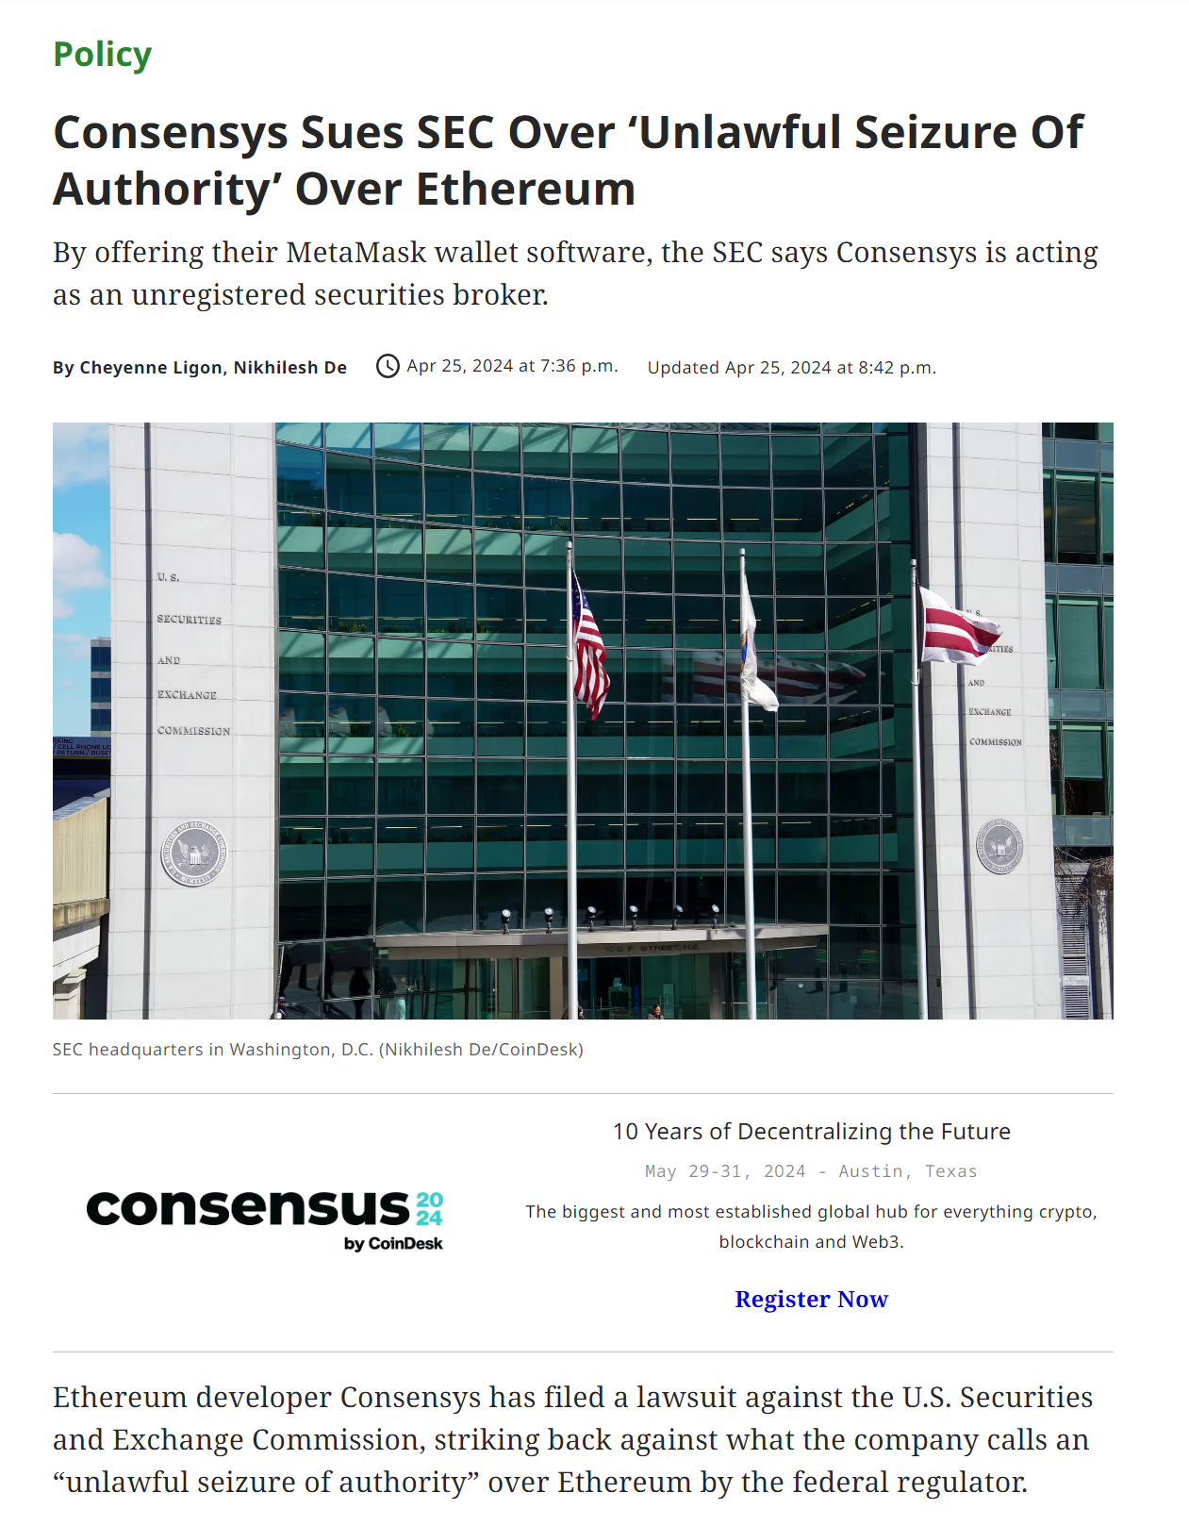
Legal Issues with Blockchain

Slide 8
Legal Issues with Blockchain – KYC and AML
KYC stands for "Know Your Customer". It's a set of regulations and procedures that financial institutions use to verify the identity of their customers and assess potential risks associated with them. Here's a breakdown of KYC:
Objectives:
Prevent money laundering and terrorist financing
Mitigate fraud risks
Comply with government regulations
Procedures:
Customer identification: Verifying name, address, date of birth, and other government-issued ID.
Customer due diligence (CDD): Assessing the nature and purpose of the customer relationship and the risks involved (e.g., source of funds, transaction patterns).
Enhanced due diligence (EDD): More in-depth checks required for higher-risk customers (e.g., politically exposed persons).
Benefits:
Increased security and stability of the financial system
Reduced opportunities for criminal activity
Improved customer experience through a streamlined onboarding process (depending on the implementation)

Slide 9
Legal Issues with Blockchain – KYC and AML
AML stands for "Anti-Money Laundering". It refers to a set of laws, regulations, and procedures that financial institutions and other regulated entities follow to prevent money laundering activities.
Money laundering is the process of disguising the illegal origin of money to make it appear legitimate. Criminals might use money laundering to hide profits from drug trafficking, fraud, or other illegal activities.
Here's how AML works:
Identification: AML regulations require institutions to identify their customers through KYC (Know Your Customer) procedures. This helps to establish who is using the financial services and reduces anonymity.
Monitoring: Institutions monitor customer transactions for suspicious activity that might indicate money laundering. This could involve large or unusual transactions, transactions inconsistent with a customer's profile, or complex transactions designed to obscure the source of funds.
Reporting: If suspicious activity is detected, institutions are required to report it to the relevant financial crime unit or authority. This allows law enforcement to investigate potential money laundering schemes.
Benefits of AML:
Reduces opportunities for criminals to benefit from their illegal activities.
Protects the integrity of the financial system by preventing criminals from infiltrating it.
Strengthens public trust in financial institutions.

Slide 10
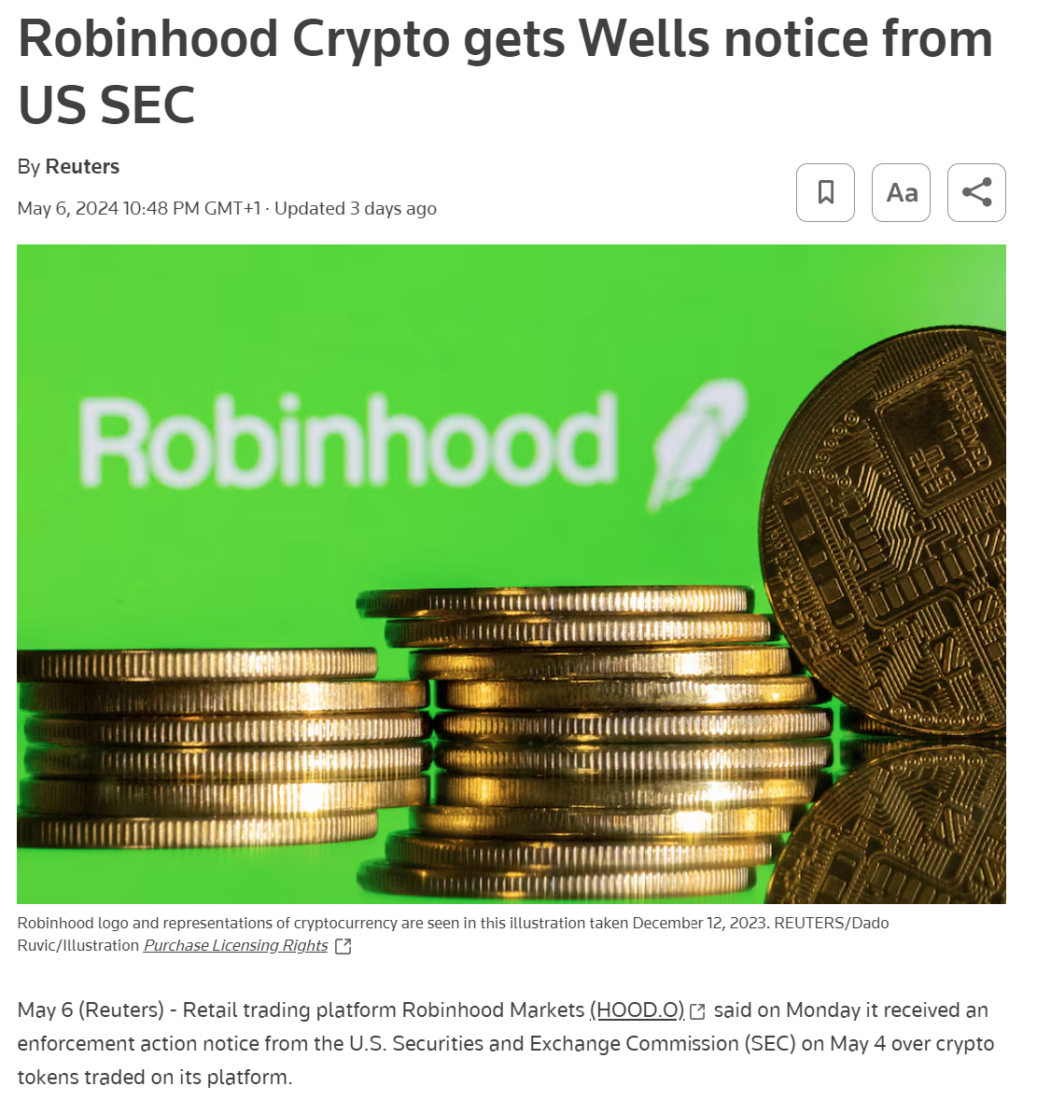
Legal Issues with Blockchain – KYC and AML

Slide 11
Legal Issues with Blockchain – KYC and AML

Slide 12
Legal Issues with Blockchain – KYC and AML
Exercise
What information do you think is important to gather during a KYC process?
What information do you think is needed to perform a thorough AML check?

Slide 13
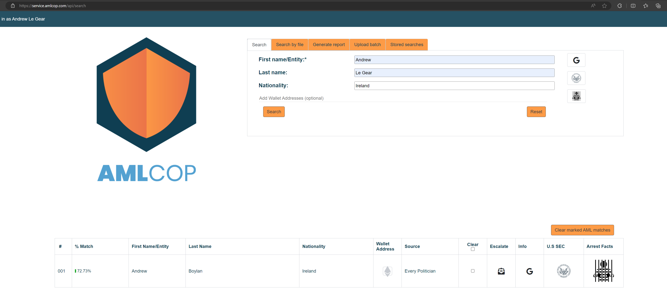

Slide 14
Legal Issues with Blockchain – KYC and AML
Dutch Lists:
• Rijksoverheid National sanctions list for terrorism
European Union Lists:
• European External Action Service (EEAS)
• European Parliament
French Lists:
• Interpol Red Notices
Hong Kong Lists:
• Hong Kong Independent Commission Against Corruption (ICAC's wanted persons)
• Hong Kong Securities & Futures Commission - Alerts
Indian Lists:
• Indian National Investigation Agency - Banned Terrorist Organisations
• List of NON BANKING FINANCIAL COMPANIES (NBFCS) holding CoR for accepting Public Deposits
• List of Non-Deposit taking Systemically Important (NBFC-ND-SI) companies registered with
• List of NBFCs not accepting Public Deposits other than NBFC-ND-SI registered with RBI
• List of the Non-Banking Financial Companies - Micro Finance Institutions (NBFC-MFIs)
• List of companies whose Certificate of Registration (CoR) has been cancelled
• List of NBFC-Factors registered with RBI
New Zealand Lists:
• New Zealand Police Wanted
Southern African Lists:
• South Africa Most Wanted
Swiss Lists:
• Swiss State Secretariat for Economic Affairs Export and Controls Sanctions List (SECO)
United Kingdom Lists:
• Her Majesty's Treasury Sanction List
USA Lists:
• Office of Foregin Assets Control(OFAC):
- Foreign Sanctions Evaders (FSE) List Sectoral
- Sanctions indentifications (SSI) List
- Palestinian Legislative Council (NS-PLC) list
- The List of Foreign Financial Institutions Subject to Part 561 (the Part 561 List)
- Non-SDN Iranian Sanctions Act (NS-ISA) List
- List of Foreign Financial Institutions Subject to Correspondent Account or Payable-Through Account Sanctions (CAPTA List)​
- Kingpin Act Wallets​
• Department of Trade Screening List
• Department of Commerce's Denied Persons List
• Department of Treasury's Specially Designated Nationals or Blocked Persons List
• Department Of State Directorate of Defense Trade Controls
• Electronic Code of Federal Regulations Entity List
• Electronic Code of Federal Regulations Unverified List
• Office of Foreign Assets Control Consolidated Sanctions List
• Chiefs Of State and Foreign Cabinet Members – CIA
• FBI Most Wanted List
• Financial Crimes Enforcement Network (FINCEN)
• Department of state Terrorist Exclusion List (DS_STEL)
• State Department Foreign Terrorist Organizations & State Department Terrorist Exclusions (SDFTO_SDTE)
• Marshal 15 Most Wanted List
• DEA Fugitives
• AFT Most Wanted
• State Department ISIS Branches and Individuals
• Diplomatic Security Service (DSS) Most wanted
• World Bank's Debarred Firms and Individuals
• SEC - Litigation Releases — Federal Court Actions
• SEC - Administrative Proceedings — Notices & Settlements
• SEC - Trading Suspensions
• SEC - Commission Opinions and Adjudicatory Orders
• SEC - Accounting and Auditing Enforcement Releases
• SEC - Reports of Investigations
• SEC - Receiverships
• SEC - Commission Amicus / Friend of the Court Briefs
• SEC - Commission Appellate Court Briefs
• SEC - Stop Orders
• SEC - Information for Harmed Investors
• SEC - Distributions in Commission Administrative Proceedings: Notices and Orders Pertaining to Disgorgement and Fair Funds
All lists:
Belgian Lists:
• Belgium Most Wanted
• Belgium national financial sanctions
Brazilian Lists:
• CEIS BR-CEIS
• CEIS CEPIM
• CEIS CNEP
• Acordos Leniencia
Canadian Lists:
• Canada Public Safaty - Listed Terrorist Entities
• Canadian Securities Administrators
• Consolidated Canadian Autonomous Sanctions List
• Financial Services Commission Of Ontario:
- Enforcement Activities
- Agents
- Corporate Agencies
- Enforcement Activities
- Agents
- Corporate Agencies
- Health care provider
- Companies
- Company representatives
- Paralegals
- Compulsasy automobile insurance act
- Mortgage brokers
- Mortgage Agents
- Mortgage Brokerages
- Mortgage Administrators
- Load trust corporation
- Credit union & Caisses populaires
Dutch Lists:
• Rijksoverheid National sanctions list for terrorism
European Union Lists:
• European External Action Service (EEAS)
• European Parliament
French Lists:
• Interpol Red Notices
Hong Kong Lists:
• Hong Kong Independent Commission Against Corruption (ICAC's wanted persons)
• Hong Kong Securities & Futures Commission - Alerts
Indian Lists:
• Indian National Investigation Agency - Banned Terrorist Organisations
• List of NON BANKING FINANCIAL COMPANIES (NBFCS) holding CoR for accepting Public Deposits
• List of Non-Deposit taking Systemically Important (NBFC-ND-SI) companies registered with
• List of NBFCs not accepting Public Deposits other than NBFC-ND-SI registered with RBI
• List of the Non-Banking Financial Companies - Micro Finance Institutions (NBFC-MFIs)
• List of companies whose Certificate of Registration (CoR) has been cancelled
• List of NBFC-Factors registered with RBI
New Zealand Lists:
• New Zealand Police Wanted
Southern African Lists:
• South Africa Most Wanted
Swiss Lists:
• Swiss State Secretariat for Economic Affairs Export and Controls Sanctions List (SECO)
United Kingdom Lists:
• Her Majesty's Treasury Sanction List
USA Lists:
• Office of Foregin Assets Control(OFAC):
- Foreign Sanctions Evaders (FSE) List Sectoral
- Sanctions indentifications (SSI) List
- Palestinian Legislative Council (NS-PLC) list
- The List of Foreign Financial Institutions Subject to Part 561 (the Part 561 List)
- Non-SDN Iranian Sanctions Act (NS-ISA) List
- List of Foreign Financial Institutions Subject to Correspondent Account or Payable-Through Account Sanctions (CAPTA List)​
- Kingpin Act Wallets​
• Department of Trade Screening List
• Department of Commerce's Denied Persons List
• Department of Treasury's Specially Designated Nationals or Blocked Persons List
• Department Of State Directorate of Defense Trade Controls
• Electronic Code of Federal Regulations Entity List
• Electronic Code of Federal Regulations Unverified List
• Office of Foreign Assets Control Consolidated Sanctions List
• Chiefs Of State and Foreign Cabinet Members – CIA
• FBI Most Wanted List
• Financial Crimes Enforcement Network (FINCEN)
• Department of state Terrorist Exclusion List (DS_STEL)
• State Department Foreign Terrorist Organizations & State Department Terrorist Exclusions (SDFTO_SDTE)
• Marshal 15 Most Wanted List
• DEA Fugitives
• AFT Most Wanted
• State Department ISIS Branches and Individuals
• Diplomatic Security Service (DSS) Most wanted
• World Bank's Debarred Firms and Individuals
• SEC - Litigation Releases — Federal Court Actions
• SEC - Administrative Proceedings — Notices & Settlements
• SEC - Trading Suspensions
• SEC - Commission Opinions and Adjudicatory Orders
• SEC - Accounting and Auditing Enforcement Releases
• SEC - Reports of Investigations
• SEC - Receiverships
• SEC - Commission Amicus / Friend of the Court Briefs
• SEC - Commission Appellate Court Briefs
• SEC - Stop Orders
• SEC - Information for Harmed Investors
• SEC - Distributions in Commission Administrative Proceedings: Notices and Orders Pertaining to Disgorgement and Fair Funds
United Nations Lists:
• United Nation Security Council Sanctions List
International Lists:
• Every Politician
• Politically Exposed Persons (PEP)
Github lists:
• Phishing Hacks Wallets
• Fake Token Wallets

Slide 15
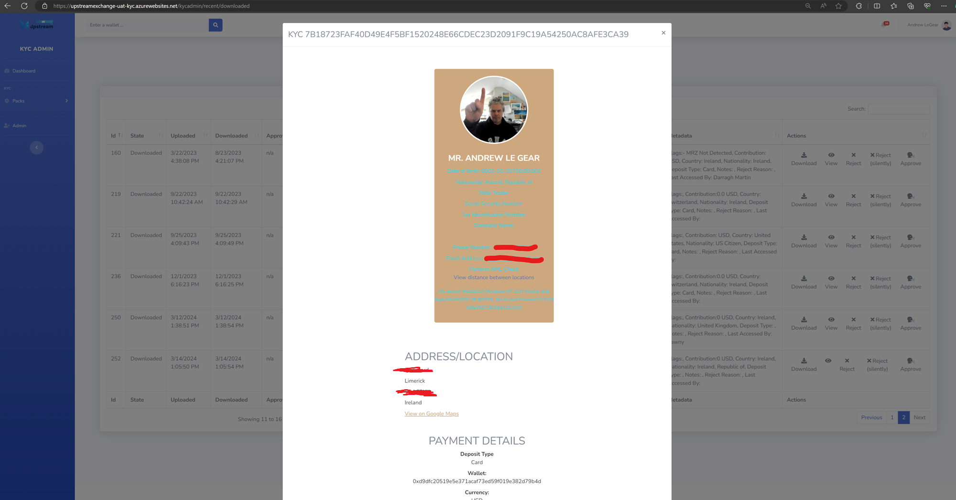

Slide 16
Legal Issues with Blockchain – KYC and AML
Further reading
Le Gear, A., 2020. A blockchain supported solution for compliant digital security offerings. Blockchain and Distributed Ledger Technology Use Cases: Applications and Lessons Learned, pp.113-131.

Slide 17
Ethical issues with blockchain - Environmental
Energy Consumption: Bitcoin mining alone is estimated to use around 110 Terawatt hours (TWh) each year, which is roughly the annual energy consumption of a small country like Malaysia or Sweden [Nasdaq: The Environmental Impact of Blockchain Technology].
Carbon Footprint: This high energy consumption translates to significant greenhouse gas emissions. Some estimates suggest Bitcoin mining could push global warming beyond the goals set out in the Paris Agreement [UNU: UN Study Reveals the Hidden Environmental Impacts of Bitcoin].
Electronic Waste: Cryptocurrencies like Bitcoin rely on specialized computer hardware for mining, and this generates a substantial amount of electronic waste. Annually, over 77 kilotons of e-waste are produced from Bitcoin mining alone [Investopedia: What's the Environmental Impact of Cryptocurrency?].
Water Usage: Beyond electricity, Bitcoin mining also has a significant water footprint. In 2020-2021, it was estimated to require 1.65 cubic kilometers of water, exceeding the domestic water use of over 300 million people in rural sub-Saharan Africa [UNU: UN Study Reveals the Hidden Environmental Impacts of Bitcoin].

Slide 18
Ethical issues with blockchain - Economic
Concentration of Wealth: Studies indicate a high concentration of wealth within some cryptocurrencies. For instance, research on wealth distribution in cryptocurrencies suggests that a small number of participants (sometimes less than 100) control over 50% of the wealth within a particular cryptocurrency [Sai, A.R., Buckley, J. and Le Gear, A., 2021. Characterizing wealth inequality in cryptocurrencies. Frontiers in blockchain, 4, p.730122.].
Libertarian economy not resulting in democratized distribution of wealth in new currencies.
Potential for Exacerbation: Some experts believe that blockchain, if not designed carefully, could mirror existing economic inequalities. The free-market nature of some blockchain ecosystems might lead to wealth accumulating in the hands of early adopters and those with significant resources for mining or investing [World Scientific: Chapter 12: The Implications of Blockchain for Income Inequality].
Access and Opportunity: There's a concern that the technical expertise required to fully participate in blockchain economies could create a barrier to entry. This could exclude those without the necessary skills or resources, potentially widening the economic gap [RMIT Research Repository: The Implications of Blockchain for Income Inequality].

Slide 19
Ethical issues with blockchain - Other
Privacy and Data Security: Blockchain transactions are often public, which can raise concerns about privacy. For example, a person's entire transaction history could be visible on a public blockchain. Additionally, blockchains can be vulnerable to hacking, which could expose sensitive data.
Not as anonymous as initially thought. Easy to identify a person by combining chain data with social media data.
Facilitation of Illegal Activities: The decentralized and anonymous nature of blockchain transactions can make it difficult to track and prevent illegal activity. For example, blockchain could be used to launder money or finance terrorism.
Libertarian approach leads to unintended facilitation of illegal activities
Lack of Regulation: Because blockchain is a relatively new technology, there is currently a lack of regulation in place. This could lead to fraud, scams, and other forms of abuse.
Possible covered under existing SEC regulations? Major crackdown by the SEC in the past 12 months.

Slide 20
Ethical issues with blockchain - Other

Slide 21
Technical Issues in Blockchain - Security
Private Key Management: Blockchain relies on public-key cryptography for security. Users need to keep their private keys safe, but if compromised, hackers can steal cryptocurrency or other digital assets.
Even worse, if lost, the assets are lost forever.
Smart Contract Vulnerabilities: Smart contracts are essentially programs running on the blockchain. Bugs or loopholes in these contracts can be exploited by malicious actors to steal funds or manipulate the system.
51% Attacks: In proof-of-work blockchains, if a miner or group of miners controls more than 50% of the mining hash rate, they could theoretically manipulate transactions or prevent new ones from being confirmed.
[Sai, A.R., Buckley, J. and Le Gear, A., 2019. Assessing the security implication of Bitcoin exchange rates. Computers & Security, 86, pp.206-222.]
Phishing and Social Engineering: Blockchain isn't immune to traditional hacking techniques. Phishing attacks can trick users into revealing their private keys or sending cryptocurrency to fraudulent addresses.
Exchange Security: Centralized cryptocurrency exchanges are a prime target for hackers, as they hold large amounts of digital assets. Breaches at exchanges can lead to significant losses for users.
[Sai, A.R., Buckley, J. and Le Gear, A., 2019. Assessing the security implication of Bitcoin exchange rates. Computers & Security, 86, pp.206-222.]

Slide 22
Technical Issues in Blockchain - Security
Exercise:
Compare technical issues on a blockchain to a traditional financial system

Slide 23
Technical Issues in Blockchain - Scalability
Limited Throughput: Traditional blockchains like Bitcoin can only process a limited number of transactions per second (TPS). This is because every node needs to validate every transaction, which can become a bottleneck as the network grows. This low TPS leads to:
Slow Confirmation Times: Transactions can take a long time to be confirmed and added to the blockchain.
High Fees: When demand for transaction processing is high, fees can surge as users compete to have their transactions included in the next block.
Side chains and Level 2 chains from the previous lecture are proposed solutions to this, sacrifice security and decentralisation.

Slide 24
Technical Issues in Blockchain - Scalability
Exercise:
Why would the mentioned scalability solutions impact decentralisation?

Slide 25
Exam
Monday 27th May
2pm - 4pm

Slide 26
Project
June 5th at 6pm

Slide 27
Questions? Best of luck in the exam! Best of luck in the project!

