Slide 1
Blockchain Technologies and Applications
ISE Block 8 – Week 5

Slide 2
Agenda
Lecture 4 and Tutorial 4 and 5 Recap
Questions from last two weeks of tutorials.
Lecture 5: Advanced Topics in Blockchain
Rollups
Bridges
Sharding
Decentralized Exchanges
Quiz
Tutorial 6 Introduction
Revisiting Ethereum’s hex protocol

Slide 3
Lecture 3 Recap
Protocols
Binary Protocol
Replacing Transactions
Storing on Bitcoin

Slide 4
Rollups
“Borrow the security features of the layer 1 blockchain to guarantee the security on another chain”
Layer 2 Scaling Solution: Rollups are a type of technology that helps blockchains process more transactions by taking them off the main blockchain (Layer 1) and processing them on a separate layer (Layer 2).
Batching Transactions: Instead of handling each transaction individually, rollups bundle a bunch of transactions together before submitting them to the main blockchain. This significantly reduces the load on the main chain.
Security Inheritance: Even though transactions occur off-chain, rollups inherit the security of the main blockchain by periodically sending compressed transaction data and cryptographic proofs back to the main chain for verification.
Two Main Types: There are two primary types of rollups: optimistic rollups and zero-knowledge rollups. They differ in how they handle fraud proofs.

Slide 5
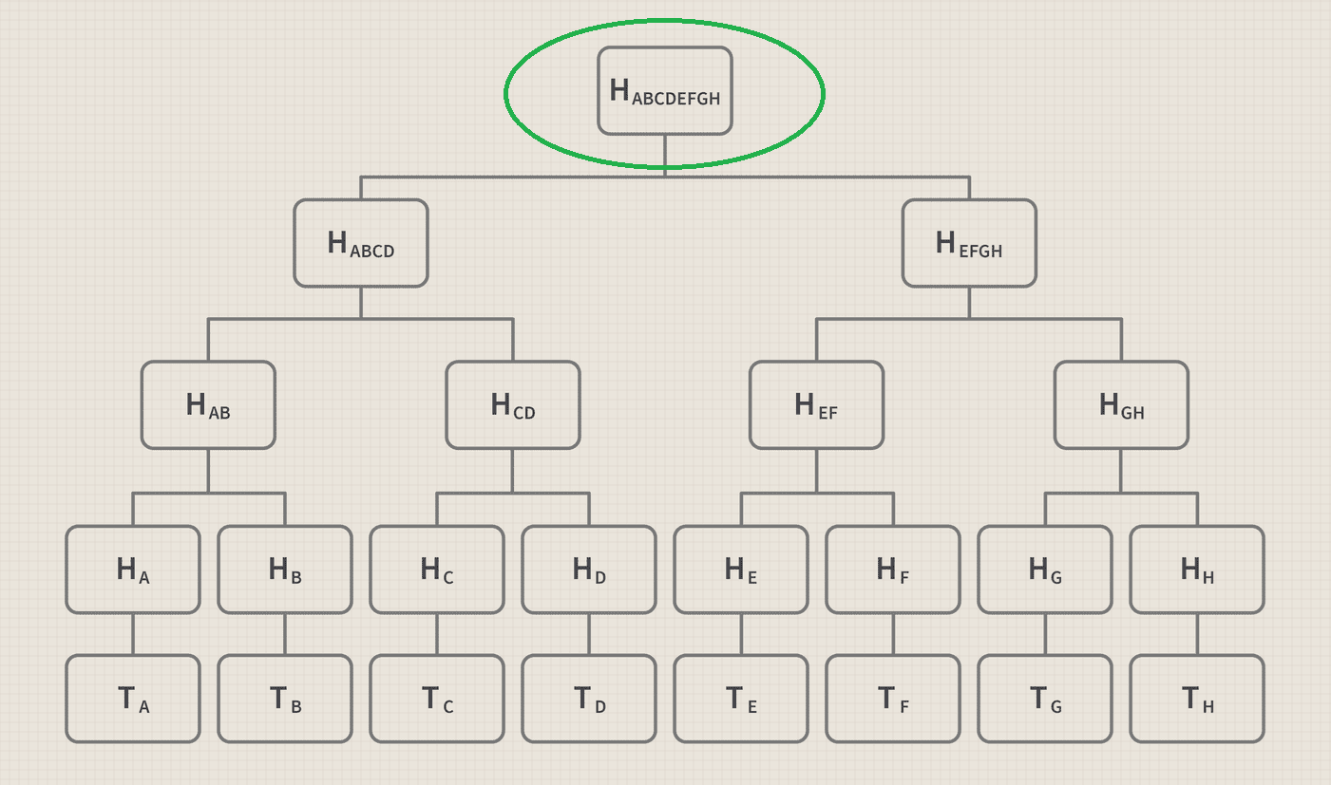
Rollups - Naive
Place the root hash of the level 2 chain on to the level 1 chain.

Slide 6
Rollups - Optimistic
An optimistic rollup is a specific type of Layer 2 scaling solution for blockchains, particularly Ethereum. Here's a breakdown of how it works:
Optimistic Assumption: Optimistic rollups take an optimistic approach, assuming all transactions processed off-chain are valid by default. This allows for faster and cheaper transactions compared to the main blockchain.
Bundling and Execution: Transactions are grouped together and processed off-chain. This significantly reduces the load on the main Ethereum blockchain.
Fraud Proofs: However, there's a built-in safety mechanism. Anyone can submit a "fraud proof" if they believe a transaction in the rollup is invalid. This proof would show how the transaction is incorrect.
Challenge Period: There's a designated "challenge period" after a batch of transactions is submitted to the main chain. During this time, anyone can submit a valid fraud proof.
Dispute Resolution: If a valid fraud proof is submitted, the faulty transaction is reversed, and the sequencer who added it might be penalized. The honest participants who helped identify the fraud get rewarded.
Security through Main Chain: Ultimately, the security of optimistic rollups relies on the underlying main chain (like Ethereum). The compressed transaction data and cryptographic proofs submitted to the main chain ensure the validity of the overall state.

Slide 7
Rollups – Optimistic – Fraud Proofs
Fraud proofs are the cornerstone of security in optimistic rollups. They act as a safety net to catch and rectify any invalid transactions that might slip through the initial optimistic processing. Here's a deeper dive into fraud proofs:
Identifying Invalidity: A fraud proof is essentially cryptographic evidence that demonstrates a specific transaction or a batch of transactions within an optimistic rollup is indeed invalid. This invalidity could take various forms, such as:
Double spending: Trying to spend the same funds twice.
Invalid state transitions: The transaction results in an illogical or impossible state in the rollup (e.g., negative balance).
Denial-of-service attack: Intentionally submitting nonsensical transactions to disrupt the rollup.
Technical Construction: Fraud proofs leverage the power of Merkle trees, a cryptographic data structure that efficiently verifies the integrity of large datasets. In optimistic rollups, the Merkle tree helps pinpoint the exact faulty transaction within a bundled batch.
Dispute Process: Anyone can submit a fraud proof during the designated challenge period. This period typically lasts several days (around a week for most optimistic rollup protocols). If a valid fraud proof is submitted, the optimistic rollup protocol triggers a dispute resolution process.

Slide 8
Rollups - Optimistic – Fraud Proofs
Dispute Resolution Outcomes: If the fraud proof is valid, the following actions occur:
The challenged transaction(s) are reverted, essentially reversing their effects on the rollup state.
The sequencer responsible for including the faulty transaction might face a penalty in the form of slashed collateral (a security deposit).
The party who submitted the valid fraud proof receives a reward for their contribution to maintaining the integrity of the rollup.
Benefits: Fraud proofs offer several advantages:
Security: They ensure that invalid transactions don't permanently corrupt the optimistic rollup state.
Decentralization: Anyone can participate in securing the network by submitting fraud proofs.
Efficiency: Fraud proofs are typically much faster and cheaper to verify compared to full transaction re-executions on the main chain.
In essence, fraud proofs act as a vigilant watchtower in optimistic rollups, ensuring the validity of transactions and maintaining the overall security of the Layer 2 scaling solution.

Slide 9
Rollups - Optimistic – Drawbacks
Delayed Finality: Unlike transactions directly on the main chain, transactions processed on optimistic rollups aren't considered truly final until the challenge period elapses. This means users might have to wait several days (depending on the specific rollup) to be certain their funds have moved irreversibly.
Vulnerability to Fraudulent Sequencers: Optimistic rollups rely on sequencers to batch and submit transactions off-chain. A malicious sequencer could theoretically include invalid transactions or manipulate the order of transactions for personal gain. While fraud proofs mitigate this risk, it emphasizes the importance of choosing a reputable and secure rollup provider.
Limited Smart Contract Functionality: Currently, optimistic rollups might not support the full spectrum of functionalities available on the main chain's smart contract environment. This can limit their applicability for certain decentralized applications (dApps) that rely on complex smart contract logic.
Potential for Censorship: There's a possibility for censorship attacks if the sequencer becomes too centralized or colludes with validators. This could lead to the blocking of specific transactions or users from the rollup. However, ongoing research is exploring ways to minimize such risks.
Data Availability Concerns: While optimistic rollups only submit compressed transaction data and proofs to the main chain, some users might be concerned about the potential lack of immediate and complete data availability on the Layer 2 side.

Slide 10
Rollups - Zero Knowledge
zk-rollups, or zero-knowledge rollups, are another type of Layer 2 scaling solution for blockchains that address some of the limitations of optimistic rollups. Here's a breakdown of zk-rollups:
Validity Proofs with Zero-Knowledge: Unlike optimistic rollups that rely on fraud proofs, zk-rollups employ a cryptographic technique called zero-knowledge proofs. These proofs allow the rollup to prove to the main chain that a batch of transactions is valid without revealing the actual transaction data itself.
Faster Finality: Thanks to zero-knowledge proofs, zk-rollups can achieve much faster transaction finality compared to optimistic rollups. Once the proof is verified on the main chain, the transactions are considered final, significantly reducing waiting times.
Enhanced Privacy: Since zk-proofs only reveal the validity of transactions without disclosing the details, zk-rollups offer a higher degree of privacy for transactions processed on the Layer 2 network.
Complex Proofs: However, generating zk-proofs can be computationally expensive compared to fraud proofs in optimistic rollups. This can impact scalability and potentially increase transaction costs on the rollup itself.

Slide 11
Rollups - Zero Knowledge
Here's a deeper look at how zk-rollups work:
Off-chain Processing: Similar to optimistic rollups, zk-rollups bundle transactions together and process them off-chain.
Validity Proof Generation: A special program called a "prover" generates a cryptographic zk-proof that mathematically demonstrates the validity of the entire transaction batch without revealing the individual transactions.
Verification on Main Chain: The zk-proof is submitted along with compressed transaction data to the main chain. Verifiers on the main chain only need to check the validity of the proof, not the entire transaction set, making verification significantly faster.
Security Inheritance: Even without revealing transaction details, the zk-proof ensures the integrity of the rollup state. In case of disputes, the complete transaction data can still be retrieved from the rollup for verification on the main chain, if necessary.

Slide 12
Rollups - Zero Knowledge
Zero-Knowledge Aspect: The key feature is the "zero-knowledge" part. The zk-proof achieves this by not revealing any details about the individual transactions themselves. It's like proving you have a certain type of fruit (say, an apple) without showing anyone the actual fruit – you just demonstrate you possess something with the required properties (round, red, etc.) using a clever cryptographic method.
Technical underpinnings: While the inner workings can get quite complex, zk-proofs rely on advanced cryptographic techniques like probabilistically checkable proofs (PCPs) or zk-SNARKs (Zero-Knowledge Succinct Non-interactive Argument of Knowledge). These techniques allow for efficient verification of complex statements without revealing the underlying data.

Slide 13
Rollups - Zero Knowledge - Drawbacks
Computational Complexity: Generating zk-proofs, especially using zk-SNARKs, can be computationally intensive. This can potentially lead to Higher Transaction Costs: The computational effort required for proof generation might translate to higher transaction fees on the zk-rollup compared to optimistic rollups.
Limited Generality: Current zk-rollup technology might not yet support the full range of functionalities available on the main blockchain's smart contract environment.
Centralization Risks: The zk-SNARK setup process can be complex and requires a high degree of trust. If not done correctly, it could introduce centralization risks if control over the setup parameters falls into the wrong hands.
Data Availability Concerns: Similar to optimistic rollups, zk-rollups only submit compressed transaction data and proofs to the main chain. While the zk-proof ensures the validity of the state, some users might be concerned about the potential lack of immediate and complete data availability on the Layer 2 side.
Evolving Technology: zk-rollups are a relatively new technology, and the underlying zk-SNARKs field is still under active research and development. While significant progress has been made, there's still room for improvement in terms of efficiency and scalability.

Slide 14
Rollup Quiz
Layer 2 rollups process transactions directly on the main blockchain.
Batching transactions in rollups reduces the load on the main blockchain.
Security inheritance allows rollups to inherit the security of the main blockchain without any verification.
In optimistic rollups, all transactions are assumed to be invalid by default.
Fraud proofs are a mechanism to identify and rectify invalid transactions in optimistic rollups.
Merkle trees help pinpoint the exact faulty transaction within a batch in optimistic rollups.
Transactions on optimistic rollups are considered final immediately after processing.
Zero-knowledge proofs in zk-rollups reveal the actual transaction data to the main chain.
Zk-rollups generally achieve faster transaction finality compared to optimistic rollups.
Optimistic rollups currently offer a wider range of functionalities for smart contracts compared to zk-rollups.

Slide 15
Rollup Quiz
Layer 2 rollups process transactions directly on the main blockchain. (False)
Batching transactions in rollups reduces the load on the main blockchain. (True)
Security inheritance allows rollups to inherit the security of the main blockchain without any verification. (False)
In optimistic rollups, all transactions are assumed to be invalid by default. (False)
Fraud proofs are a mechanism to identify and rectify invalid transactions in optimistic rollups. (True)
Merkle trees help pinpoint the exact faulty transaction within a batch in optimistic rollups. (True)
Transactions on optimistic rollups are considered final immediately after processing. (False)
Zero-knowledge proofs in zk-rollups reveal the actual transaction data to the main chain. (False)
Zk-rollups generally achieve faster transaction finality compared to optimistic rollups. (True)
Optimistic rollups currently offer a wider range of functionalities for smart contracts compared to zk-rollups. (True)

Slide 16
Bridges
Blockchain bridges are essentially gateways that connect different blockchains, allowing them to communicate and transfer data or assets between each other. Imagine them as bridges over separate islands, enabling movement and interaction across previously isolated ecosystems.
Here's a breakdown of key points about blockchain bridges:
Purpose: They address the issue of siloed blockchains, each with its own set of rules and functionalities. Bridges create interoperability, fostering a more connected and collaborative blockchain landscape.
Functionality: There are two main ways bridges facilitate asset transfer:
Wrapped Assets: This approach creates a "wrapped" version of the original asset on the target blockchain. For instance, a Bitcoin wrapped on Ethereum would be called WBTC. The original asset is locked on the source chain, and an equivalent amount of wrapped tokens are issued on the target chain. When transferring back, the wrapped asset is burned, and the original asset is released on the source chain.
Liquidity Pools: Bridges can leverage liquidity pools to facilitate asset exchange. Users deposit funds into the pool on both sides of the bridge, and the bridge algorithm facilitates automated swaps between the two assets.

Slide 17
Bridges
Types of Bridges: There are two main categories of bridges:
Centralized Bridges: These bridges rely on a central authority to manage the locking and releasing of assets, similar to a custodian holding the keys. While faster and simpler to set up, they introduce a single point of failure and potential trust concerns.
Decentralized Bridges: These bridges eliminate the need for a central authority. They use smart contracts and economic incentives to ensure the secure transfer of assets. However, they can be more complex to develop and might have slower transaction times.
Benefits: Blockchain bridges offer several advantages:
Increased interoperability: They enable users to leverage different blockchains based on their specific needs, such as accessing faster transactions on one chain or more advanced functionalities on another.
Enhanced DeFi ecosystem: Bridges unlock a wider range of DeFi (decentralized finance) applications by allowing users to move assets seamlessly between different DeFi protocols built on separate blockchains.
Improved liquidity: Bridges can contribute to increased liquidity in DeFi markets by enabling assets to flow more freely across different blockchain networks.
Drawbacks: Despite the benefits, there are some challenges to consider:
Security risks: Bridges, especially centralized ones, can be vulnerable to hacks or exploits if not implemented securely.
Complexity: Understanding how bridges work and the associated risks can be challenging for new users.
Limited functionality: Not all bridges support all types of assets or blockchain networks.

Slide 18
Bridges - Examples
Ethereum Chain
Bitcoin Chain
BTC Holder
Bridge Wallet
Bridge Wallet
WBTC Holder
Sniffer Process
Traditional Server

Slide 19
Sharding
scaling solution that aims to address the limitations of the current single-chain architecture. Here's how sharding would work for Ethereum:
Network Division: The Ethereum network would be split into multiple horizontal sections called shards. Each shard acts like a mini-blockchain, processing its own set of transactions and maintaining its own state (account balances, smart contract code).
Transaction Distribution: Transactions wouldn't be broadcast to the entire network anymore. Instead, a mechanism would distribute transactions to the relevant shard based on a predetermined sharding key. This key could be an aspect of the transaction itself, like a user address or a smart contract identifier.
Parallel Processing: Shards would operate in parallel, processing transactions simultaneously. This significantly increases the overall throughput of the Ethereum network compared to the current system where all transactions are processed sequentially on the main chain.

Slide 20
Sharding
Benefits: Sharding offers several advantages for Ethereum:
Increased Scalability: Sharding allows Ethereum to handle a much larger volume of transactions per second (TPS), overcoming the limitations of the current single-chain design.
Reduced Congestion: By distributing the load across multiple shards, sharding can alleviate network congestion and lower gas fees, which are a major pain point for Ethereum users.
Improved Decentralization: Sharding can potentially lead to a more decentralized network as the computational requirements for running a full node would be reduced. More people might be able to participate in validating transactions on their respective shards.
Challenges: While sharding holds promise, it also presents some challenges:
Increased Complexity: Implementing and maintaining a sharded network is significantly more complex compared to the current single-chain architecture. New protocols for communication and coordination between shards need to be developed.
Security Considerations: Security guarantees in a sharded network can be more intricate. Ensuring data consistency across shards and preventing malicious actors from exploiting vulnerabilities across multiple shards requires careful design and implementation.
Data Availability: Not all data might be readily available on every node. Nodes might need to interact with other shards to access specific information, potentially impacting user experience and application development.

Slide 21
Sharding
Current Status: Sharding is still under development for Ethereum. The Ethereum developers are actively researching and testing different sharding implementations. While there's no exact timeline for its full deployment, it's expected to be a key component of Ethereum's scaling roadmap in the future.

Slide 22
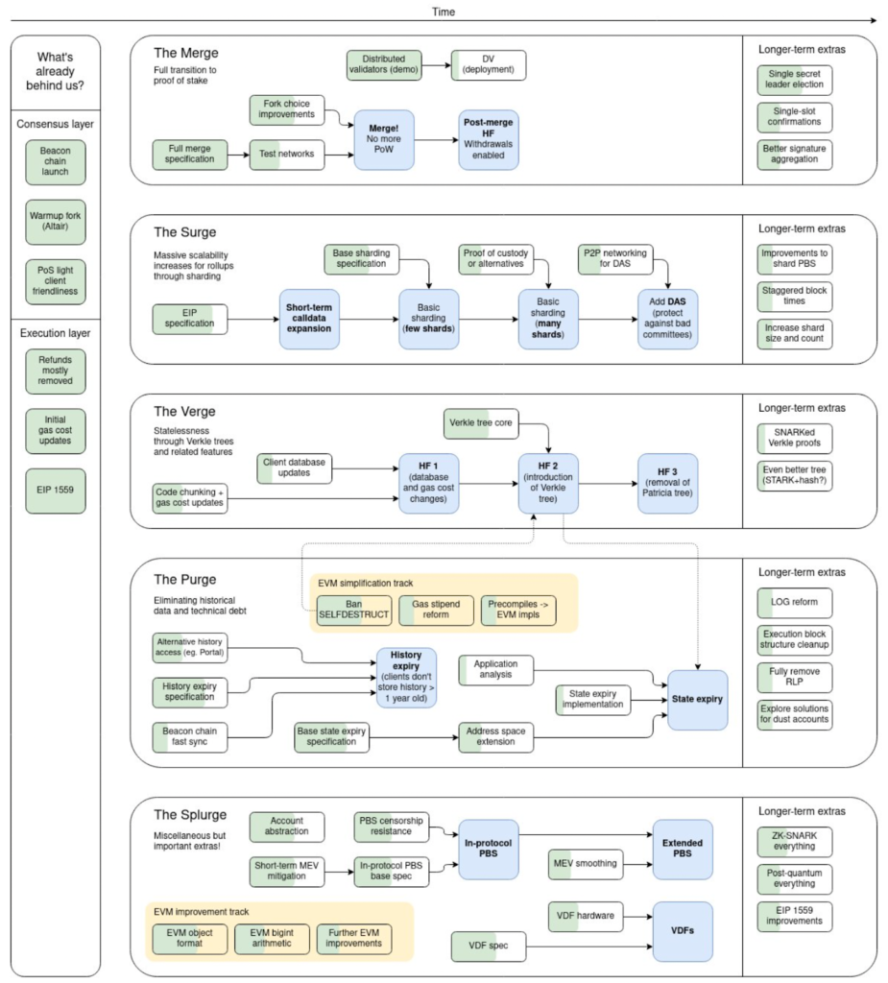
Ethereum Roadmap

Slide 23
Quiz
True or False: Blockchain bridges connect different blockchains, allowing them to transfer data and assets.
True or False: Blockchain bridges aim to fix the problem of disconnected blockchains that cannot communicate.
True or False: When using wrapped assets, the original asset is destroyed on the source blockchain.
True or False: Liquidity pools rely on users depositing funds on both sides of the bridge to facilitate transfers.
True or False: Centralized bridges are faster and easier to set up compared to decentralized bridges.
True or False: Decentralized bridges rely on smart contracts to guarantee secure asset transfers.
True or False: One benefit of blockchain bridges is enabling users to leverage different blockchains for their strengths.
True or False: Blockchain bridges eliminate all security risks associated with transferring assets across blockchains.
True or False: Sharding is a proposed solution to increase the scalability of the Ethereum network.
True or False: Sharding would distribute transactions across multiple mini-blockchains for faster processing.

Slide 24
Quiz
True or False: Blockchain bridges connect different blockchains, allowing them to transfer data and assets. True
True or False: Blockchain bridges aim to fix the problem of disconnected blockchains that cannot communicate. True
True or False: When using wrapped assets, the original asset is destroyed on the source blockchain. False (The original asset is locked, not destroyed)
True or False: Liquidity pools rely on users depositing funds on both sides of the bridge to facilitate transfers. True
True or False: Centralized bridges are faster and easier to set up compared to decentralized bridges. True
True or False: Decentralized bridges rely on smart contracts to guarantee secure asset transfers. True
True or False: One benefit of blockchain bridges is enabling users to leverage different blockchains for their strengths. True
True or False: Blockchain bridges eliminate all security risks associated with transferring assets across blockchains. False (Bridges themselves can be vulnerable)
True or False: Sharding is a proposed solution to increase the scalability of the Ethereum network. True
True or False: Sharding would distribute transactions across multiple mini-blockchains for faster processing. True (These mini-blockchains are called shards)

Slide 25
Decentralized Exchanges - Uniswap
Uniswap is a leading decentralized exchange (DEX) built on the Ethereum blockchain. Unlike centralized exchanges like Coinbase or Binance, Uniswap doesn't rely on a middleman to facilitate cryptocurrency trading. Instead, it uses an automated process powered by smart contracts. Here's a breakdown of Uniswap:
Decentralized Exchange (DEX):
Traditional exchanges hold user funds and control order matching. In contrast, Uniswap is a DEX, meaning users retain custody of their crypto assets throughout the trading process.
Automated Market Making (AMM):
Uniswap doesn't rely on order books like traditional exchanges. Instead, it uses an AMM model. Here, liquidity pools act as the counterparty for trades, eliminating the need for waiting for another user to place an opposing order.
Liquidity Pools:
These are smart contract-managed reserves of cryptocurrencies. Users can deposit their holdings into these pools to earn fees on trading activity. The pool's depth (amount of tokens) determines the price and liquidity for a particular trading pair (e.g., ETH/DAI).

Slide 26
Decentralized Exchanges - Uniswap
How Uniswap Works:
Adding Liquidity: Users can contribute crypto assets to liquidity pools, increasing the pool's depth and earning fees from trades proportional to their contribution.
Swapping Tokens: When a user wants to swap one token for another (e.g., ETH for DAI), they interact with a liquidity pool. The swap is facilitated by the AMM algorithm based on a constant product formula, ensuring there's always sufficient liquidity on both sides of the pool.

Slide 27
Decentralized Exchanges - Uniswap
Automated Pricing: The AMM algorithm automatically adjusts prices based on supply and demand within the liquidity pool. The price changes as the ratio of tokens in the pool shifts due to trading activity.
Benefits of Uniswap:
Decentralization: Users maintain control over their crypto assets throughout the trading process.
Permissionless: Anyone can participate in trading and liquidity provision without needing approval.
Fast and Efficient: Trades are facilitated quickly through automated smart contracts.
Wide Range of Tokens: Uniswap supports a vast array of cryptocurrencies and tokens due to its open nature.
Drawbacks of Uniswap:
Impermanent Loss: Liquidity providers can experience impermanent loss if the price of their deposited tokens fluctuates significantly.
Price Slippage: When swapping large quantities of tokens, the price users receive might differ slightly from the initially quoted price due to pool rebalancing.
Security Risks: Smart contract vulnerabilities could potentially lead to exploits or hacks. It's crucial to choose reputable liquidity pools.

Slide 28
Decentralized Exchanges – Uniswap – Constant Product
The constant product formula is a key concept in understanding Automated Market Makers (AMMs) like Uniswap. It dictates the relationship between the quantities of two tokens in a liquidity pool and their price. Here's how it works:
Formula: The formula itself is quite simple: X * Y = K
X: Represents the quantity of one token in the liquidity pool.
Y: Represents the quantity of the other token in the liquidity pool.
K: This is the constant product, a fixed value for a particular liquidity pool. It remains constant regardless of trading activity.
Essentially, the constant product formula ensures there's always a specific balance between the two tokens in the pool.

Slide 29
Decentralized Exchanges – Uniswap – Constant Product
Understanding with an Example:
Imagine a liquidity pool with two tokens: ETH (Ether) and DAI (a stablecoin pegged to the US dollar). Let's say the initial state of the pool is:
X (ETH): 100 ETH
Y (DAI): 10,000 DAI
Therefore, the initial constant product (K) would be:
K = X * Y = 100 ETH * 10,000 DAI = 1,000,000

Slide 30
Decentralized Exchanges – Uniswap – Constant Product
Now, let's say a user wants to buy 10 ETH using DAI.
To maintain the constant product (K), the amount of DAI in the pool (Y) needs to decrease as ETH (X) increases.
The AMM automatically adjusts the price to incentivize this change.
As more DAI is taken out to buy ETH, the remaining DAI becomes more valuable relative to ETH, driving its price up.
Uniswap doesn't directly tell you the price; it uses the constant product formula to determine it based on the available supply in the pool.

Slide 31
Decentralized Exchanges – Uniswap – Constant Product
After the trade:
Let's say the new amount of DAI (Y') in the pool is 9,000 DAI (after selling 1000 DAI worth of ETH).
To maintain the constant product (K), the new amount of ETH (X') in the pool must be:
X' = K / Y' = 1,000,000 DAI / 9,000 DAI = 111.11 ETH (approximately)
This shows how the price of ETH increased slightly (from 10 DAI per ETH to roughly 9 DAI per ETH) due to the trade. The constant product formula ensures the pool remains balanced while facilitating trades.
Remember:
The constant product formula helps maintain liquidity but doesn't guarantee a fixed price for tokens. Prices fluctuate based on supply and demand within the pool.
This is a simplified example. Real-world liquidity pools can have complex pricing dynamics influenced by factors like fees and pool depth.

Slide 32
Exercise – Constant Product
A Uniswap liquidity pool holds 100,000 USDC (Y) and 100 LINK tokens (X).
What is the constant product (K) for this pool ?
Calculate the starting price of a LINK token in USDC before the trade.
3.
Scenario: A trader wants to buy 20 LINK tokens using USDC. Calculate the amount of USDC (Y') the trader needs to spend to buy 20 LINK tokens (X') according to the constant product formula.
4. What is the new price

Slide 33
Tutorial 6 Primer
Reread the Ethereum protocol section from lecture 4
Practice creating the data field for Json RPC requests.

Slide 34
Questions? Brightspace Link Available to Upload Projects Tutorial Tomorrow 11-1

