Slide 1
Blockchain Technologies and Applications
ISE Block 8 – Week 4

Slide 2
Agenda
Lecture and Tutorial 3 Recap
Questions from last week.
Lecture 4: Transaction Protocols
Bitcoin Transaction Model – UTXO
Ethereum Transactions – JSON RPC Binary Interface
Interesting transactions:
Replacing a transaction in Ethereum
Storing information on the Bitcoin Blockchain
Quiz
Tutorial 4 Introduction
Payables

Slide 3
Lecture 3 Recap
Consensus Mechanisms
Nakamoto Consensus
PoW
Forks
PoS
PoA
PoH

Slide 4
Tutorial 3 Recap – ERC-20
The IERC20 interface (lines 4-12) defines the standard functions and events that any ERC20 token contract should implement. These include totalSupply, balanceOf, transfer, allowance, approve, transferFrom, Transfer event, and Approval event.
interface IERC20 {
function totalSupply() external view returns (uint256);
function balanceOf(address account) external view returns (uint256);
function transfer(address recipient, uint256 amount) external returns (bool);
function allowance(address owner, address spender) external view returns (uint256);
function approve(address spender, uint256 amount) external returns (bool);
function transferFrom(address sender, address recipient, uint256 amount) external returns (bool);
event Transfer(address indexed from, address indexed to, uint256 value);
event Approval(address indexed owner, address indexed spender, uint256 value);
}

Slide 5
Tutorial 3 Recap – ERC-20
The AndyToken contract (line 14 onwards) implements the IERC20 interface. It has state variables for the token's name, symbol, decimals, total supply, balances of addresses, and allowances for each address to spend on behalf of others (lines 16-20).
The constructor (lines 22-28) sets the token's name, symbol, decimals, and initial supply. It also assigns the total supply to the deployer of the contract and emits a Transfer event.
constructor(string memory _name, string memory _symbol, uint8 _decimals, uint256 initialSupply) {
name = _name;
symbol = _symbol;
decimals = _decimals;
_totalSupply = initialSupply * 10**uint256(decimals);
_balances[msg.sender] = _totalSupply;
emit Transfer(address(0), msg.sender, _totalSupply);
}

Slide 6
Tutorial 3 Recap – ERC-20
The totalSupply function (lines 30-32) returns the total supply of tokens.
The balanceOf function (lines 34-36) returns the balance of a given account.
The transfer function (lines 38-41) transfers tokens from the message sender to a recipient.
The allowance function (lines 43-45) returns the amount of tokens that an owner allowed to a spender.
The approve function (lines 47-50) sets the amount of tokens that a spender is allowed to spend on behalf of the message sender.
The transferFrom function (lines 52-55) transfers tokens from a sender to a recipient and adjusts the allowance accordingly.
function totalSupply() external view override returns (uint256) {
return _totalSupply;
}
function balanceOf(address account) external view override returns (uint256) {
return _balances[account];
}
function transfer(address recipient, uint256 amount) external override returns (bool) {
_transfer(msg.sender, recipient, amount);
return true;
}
function allowance(address owner, address spender) external view override returns (uint256) {
return _allowances[owner][spender];
}
function approve(address spender, uint256 amount) external override returns (bool) {
_approve(msg.sender, spender, amount);
return true;
}
function transferFrom(address sender, address recipient, uint256 amount) external override returns (bool) {
_transfer(sender, recipient, amount);
_approve(sender, msg.sender, _allowances[sender][msg.sender] - amount);
return true;
}

Slide 7
Tutorial 3 Recap – ERC-20
The _transfer internal function (lines 57-65) transfers tokens from a sender to a recipient, emits a Transfer event, and includes checks to prevent certain erroneous actions (like transferring more tokens than one has or transferring from/to the zero address).
function _transfer(address sender, address recipient, uint256 amount) internal {
require(sender != address(0), "ERC20: transfer from the zero address");
require(recipient != address(0), "ERC20: transfer to the zero address");
require(_balances[sender] >= amount, "ERC20: transfer amount exceeds balance");
_balances[sender] -= amount;
_balances[recipient] += amount;
emit Transfer(sender, recipient, amount);
}
The _approve internal function (lines 67-73) sets the amount of tokens that a spender is allowed to spend on behalf of an owner, emits an Approval event, and includes checks to prevent approving from/to the zero address.
function _approve(address owner, address spender, uint256 amount) internal {
require(owner != address(0), "ERC20: approve from the zero address");
require(spender != address(0), "ERC20: approve to the zero address");
_allowances[owner][spender] = amount;
emit Approval(owner, spender, amount);
}

Slide 8
Tutorial 3 Recap – ERC-20
var wallet = “…”;
var contractAddress = “…”;
var contract = new web3.eth.Contract(ABI, contractAddress);
var amount = web3.utils.toWei('1', 'ether');; // 1 token
var transaction = contract.methods.transfer(tokenAddress, amount);
var encodedABI = transaction.encodeABI();
var tx = {
from: wallet.address,
to: contractAddress,
gas: 2000000,
data: encodedABI
};
web3.eth.accounts.signTransaction(tx, privateKey).then(function(signedTx){
web3.eth.sendSignedTransaction(signedTx.rawTransaction).on('receipt', function(receipt){
// … Display a result
});
});

Slide 9
Transaction Protocols – Bitcoin Transaction Model
Understanding Bitcoin UTXOs: A Breakdown
UTXOs (Unspent Transaction Outputs) are the foundation of how Bitcoin transactions work. They represent individual units of Bitcoin that haven't been spent yet. Here's a detailed breakdown:
What is a UTXO?
Think of it as a coin in your wallet. Each UTXO holds a specific amount of Bitcoin (in satoshis, the smallest unit, the equivalent of wei on Ethereum).
It originates as an output from a previous transaction where someone sent you Bitcoin.
Unlike traditional accounts, UTXOs are independent and cannot be divided.
UTXOs and Transactions:
Spending UTXOs:
When you make a Bitcoin payment, your wallet selects enough UTXOs to cover the amount you're sending.
The entire UTXO is used, not a portion.
Change Outputs:
If the total value of used UTXOs is more than the payment amount, the remaining balance is returned as a new UTXO (change).
This "change" UTXO goes back to your wallet address.
Transaction Inputs & Outputs:
A Bitcoin transaction has two parts: inputs (UTXOs you're spending) and outputs (new UTXOs created).
The total value of input UTXOs must equal the sum of the outgoing payment and any change returned.

Slide 10
Transaction Protocols – Bitcoin Transaction Model
UTXOs and Your Balance:
Your Bitcoin wallet balance isn't stored in one place.
It's the sum of all UTXOs associated with your wallet addresses.
Your wallet software scans the blockchain to find all your UTXOs and calculates the total value.
Additional Points:
UTXOs are public information on the blockchain. Anyone can see them, but only someone with the private key can spend them.
Managing UTXOs can be complex. Some wallets offer features to consolidate UTXOs for better transaction efficiency.
In essence, UTXOs act like individual coins you spend and receive change for, forming a unique record of ownership on the Bitcoin blockchain.

Slide 11
Transaction Protocols – Bitcoin Transaction Model
Example: Transaction 1
Transaction.
Signed by d
UTXO 1: value 1BTC: from a
UTXO 4: value 2.5BTC: to e
Outputs
Inputs
UTXO 2 : value 1BTC: from b
UTXO 5: value 0.25BTC: to d
UTXO 3 : value 1BTC: from c
value 0.25BTC fee

Slide 12
Transaction Protocols – Bitcoin Transaction Model
{
"jsonrpc": "1.0",
"id": "my_transaction",
"method": "createrawtransaction",
"params": [
[
{
"txid": "txid_of_input_1",
"vout": 0 // Index of the output being spent in txid_of_input_1
},
{
"txid": "txid_of_input_2",
"vout": 1 // Index of the output being spent in txid_of_input_2
}
], // Array of UTXOs to be spent
{
"address_1": 0.001, // Output to recipient 1 with amount 0.001 BTC
"address_2": 0.0005, // Output to recipient 2 with amount 0.0005 BTC
"your_own_address": "your_bitcoin_address" // Output sending remainder back to yourself
},
{ // Optional fee rate (in satoshis per byte)
"replaceable": true // Optional, allows for replacing with higher fee tx
}
]
}

Slide 13
Transaction Protocols – Bitcoin Transaction Model
Explanation:
method: This is set to "createrawtransaction" to instruct the Bitcoin software to construct a raw transaction.
params: This array contains the arguments for the method:
[0]: This is an array containing information about the UTXOs (Unspent Transaction Outputs) to be spent in the transaction.
Each element is an object with:
txid: The transaction ID of the UTXO.
vout: The index (vout) of the specific output within the transaction identified by txid that is being spent.
[1]: This is another array containing the desired outputs of the transaction.
Each element is an object with:
address: The Bitcoin address of the recipient or your own address for the remainder.
amount: The amount of BTC to be sent to that address.
[2]: This is an optional object for specifying fee related options.
replaceable: This boolean value allows the transaction to be replaced with a higher fee transaction if needed (not always supported by all software).

Slide 14
Transaction Protocols – Ethereum JSON RPC
Interaction method: JSON-RPC (JSON Remote Procedure Call) is a way for software applications to communicate with Ethereum nodes.
Data format: It uses JSON format for sending and receiving data, making it lightweight and human-readable.
Standardized access: All Ethereum clients implement JSON-RPC, providing a standard set of methods for applications to interact with the blockchain regardless of the specific client.
Functionalities: Applications can use JSON-RPC to perform various actions like: * Reading data from the blockchain (block details, transaction history, account balances) * Sending transactions to the network
Transport agnostic: JSON-RPC can be used over different communication channels like HTTP or WebSockets.

Slide 15
Transaction Protocols – Ethereum JSON RPC
Construct the JSON Payload:
The JSON payload specifies the RPC method and parameters. Here's what you'll include:
jsonrpc: Set to "2.0" for the JSON-RPC version.
method: Set to "eth_call" as we're using the Ethereum node for this call. eth_call is used for read operations. No transaction occurs.
id: A unique identifier for your request (any number will do).
params: An array containing details about the call:
to: The address of the ERC-20 token contract.
data: We need to construct the data field using the function signature and wallet address.

Slide 16
Transaction Protocols – Ethereum JSON RPC
Building the data field:
Function Signature: ERC-20 tokens have a standard function called "balanceOf(address)" to retrieve the balance for a specific address.
Get the Keccak-256 hash of the function signature "balanceOf(address)". You can find online tools for this. The hash will start with "0x".
Extract the first 4 bytes (8 characters) of the hash. This represents the function selector for "balanceOf".
Wallet Address: Convert the wallet address to hexadecimal format and remove the "0x" prefix.
Combine them:
[1] function selector
[2] A fixed length parameter (e.g. address, uint256) is allocated a 32-byte space in the protocol. You have one parameter in this case. And address is 20 bytes long. Pad with a an additional 12 bytes of 0’s to total 32 bytes. Each byte in hex is 2 characters, so you will result with a 64 character hex string.

Slide 17
Transaction Protocols – Ethereum JSON RPC
Example:
Let's say the Keccak-256 hash of "balanceOf(address)" is "0x70a08231b98ef4ca268c9cc3f6b4590e4bfec28280db06bb5d45e689f2a360be" and the wallet address is "0x1234567890AbCdEf1234567890AbCdEf12345678".
Function selector: 0x70a08231
Wallet address (hex): 1234567890abcdef1234567890abcdef12345678
Combine: 0x70a082310000000000000000000000001234567890abcdef1234567890abcdef12345678

Slide 18
Transaction Protocols – Ethereum JSON RPC
{
"jsonrpc": "2.0",
"method": "eth_call",
"id": 1,
"params": [
{
"to": "0x<ERC20_Contract_Address>", // Replace with actual contract address
"data": "0x70a082310000000000000000000000001234567890abcdef1234567890abcdef12345678"
}
]
}
Send the Request:
Use the JSON payload to make a POST request to your Ethereum node URL with "Content-Type: application/json" header.
Parse the Response:
The response will also be in JSON format. If successful, it will contain a "result" field with the ERC-20 token balance for the wallet address in hexadecimal format. You'll need to convert this value to a human-readable format based on the token's decimals.

Slide 19
Transaction Protocols – Ethereum JSON RPC
Exercise:
Use your favourite http sender (curl, postman, Get-Content, etc) to send a JSON RPC request to your ERC-20 from the last tutorial to check the balance.

Slide 20
Transaction Protocols – Ethereum JSON RPC
Sending a Transaction – Type 1 – Unlocked Account on Personal Ethereum Node
Construct the JSON Payload:
Similar to the balance check, we'll use the "eth_sendTransaction" method. Here's the breakdown:
jsonrpc: Set to "2.0".
method: Set to "eth_sendTransaction".
id: A unique identifier for your request.
params: An array containing transaction details:
from: The address sending the tokens.
to: The address receiving the tokens.
gas: The maximum amount of gas you're willing to spend for the transaction (refer to Ethereum gas estimation tools).
gasPrice: The gas price you're willing to pay per unit of gas (affects transaction speed and confirmation time).
data: This field contains the encoded function call for the transfer.

Slide 21
Transaction Protocols – Ethereum JSON RPC
Building the data field:
Function Signature: The ERC-20 "transfer(address,uint256)" function transfers tokens to a recipient.
Get the Keccak-256 hash of "transfer(address,uint256)".
Extract the first 4 bytes (8 characters) of the hash for the function selector.
Recipient Address: Convert the recipient address to hexadecimal format and remove the "0x" prefix.
Transfer Amount: Convert the transfer amount from tokens to Wei (the smallest denomination of Ether). You can use online conversion tools. Then, convert the Wei value to hexadecimal format without the "0x" prefix.
Combine them:
Append padded 64 byte address as with the previous example
Append the transfer amount in hexadecimal format (padded with zeros if necessary to make it 32 bytes long).

Slide 22
Transaction Protocols – Ethereum JSON RPC
Exercise:
Construct the Data Field
Let's say the Keccak-256 hash of "transfer(address,uint256)" is "0xa9059cbb" and you want to transfer 10 tokens (assuming 18 decimals for the token).

Slide 23
Transaction Protocols – Interesting Cases – Storing Information on the Bitcoin Blockchain
Conventional wisdom is that Bitcoin can only store transactions on it’s ledger.
No ability for smart contracts
True
But some basic scripting operations do exist.
OP_CHECKSIG: This opcode is crucial for securing transactions. It verifies the validity of a signature by comparing it with the public key and the transaction hash. If the signature matches, it allows the spending of the associated bitcoins.
OP_EQUAL: This opcode performs a simple comparison between the top elements on the stack. It returns a 1 if the elements are equal and a 0 otherwise. This opcode is often used in conjunction with other opcodes to create more complex spending conditions.
These opcodes play a central role in Bitcoin's scripting system, which defines how bitcoins can be spent. By utilizing these opcodes, Bitcoin ensures secure and controlled transactions on its blockchain.

Slide 24
Transaction Protocols – Interesting Cases – Storing Information on the Bitcoin Blockchain
OP_RETURN.
However, it's important to understand some key points about using OP_RETURN for data storage:
Limited Functionality: Bitcoin, by design, prioritizes security and transaction validation over general data storage. OP_RETURN allows embedding data within a transaction, but it doesn't validate or process the information.
Unspendable Outputs: Transactions with OP_RETURN are designed to be unspendable. The script containing the data is marked invalid, preventing anyone from claiming the bitcoins attached to the output.
Data Size Limitations: While you can store arbitrary data with OP_RETURN, there are practical limitations on the amount due to transaction fees. Including a large amount of data can become very expensive.
In essence, OP_RETURN lets you etch information onto the blockchain, but it's not ideal for storing large amounts of critical data.

Slide 25
Transaction Protocols – Interesting Cases – Storing Information on the Bitcoin Blockchain
In Horizon we used the OP_RETURN feature to “rollup” to the Bitcoin blockchain
Store the current merkel tree root hash from our private chain to Bitcoin
Using the security properties of another chain to verify your own chain
https://blockstream.info/tx/43fde2632b6d1b62a3cdba89d146950662e441033861fcb15aa8f14757c85e5b?expand

Slide 26
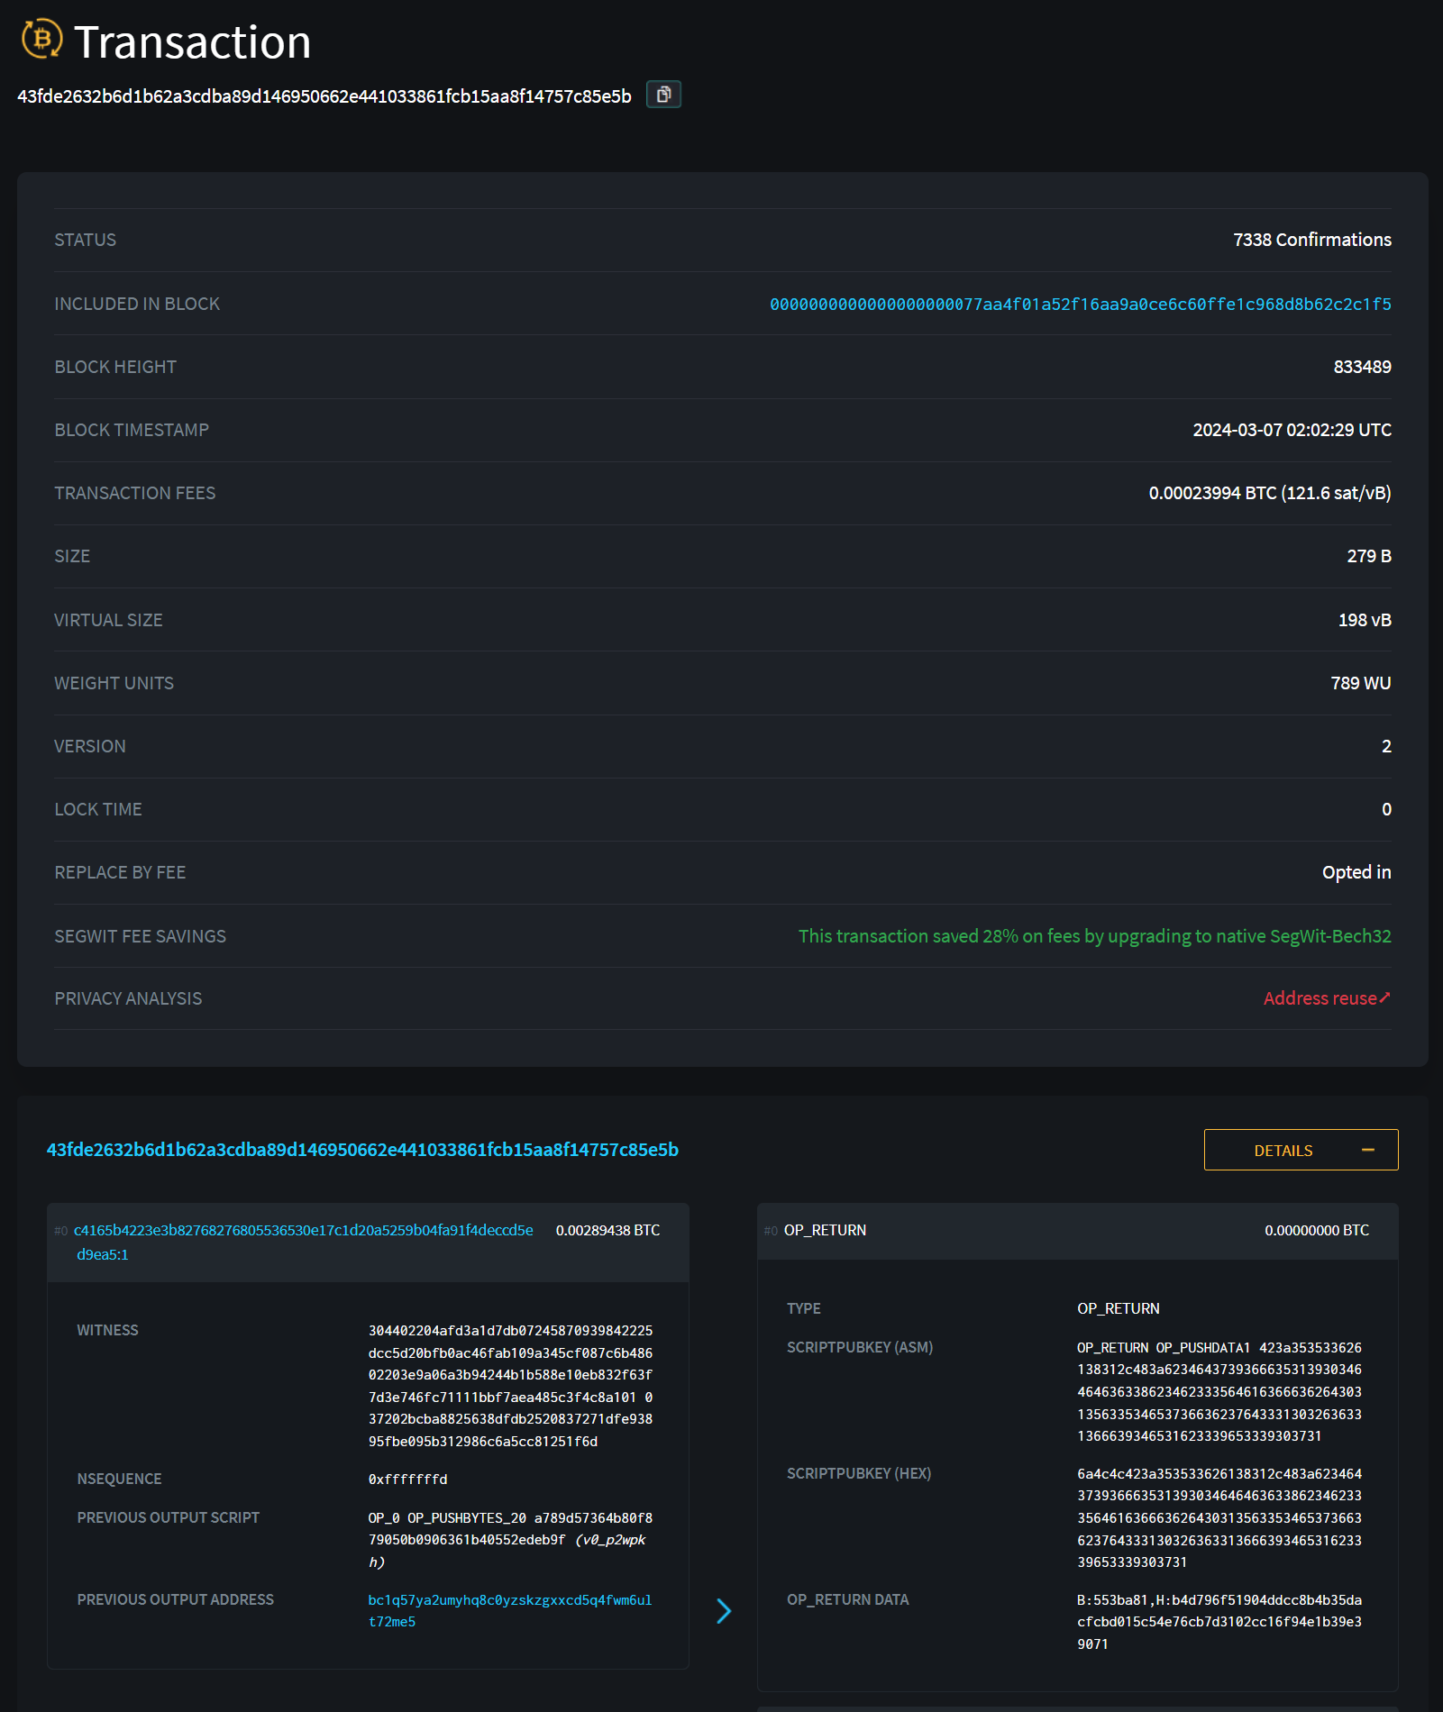

Slide 27
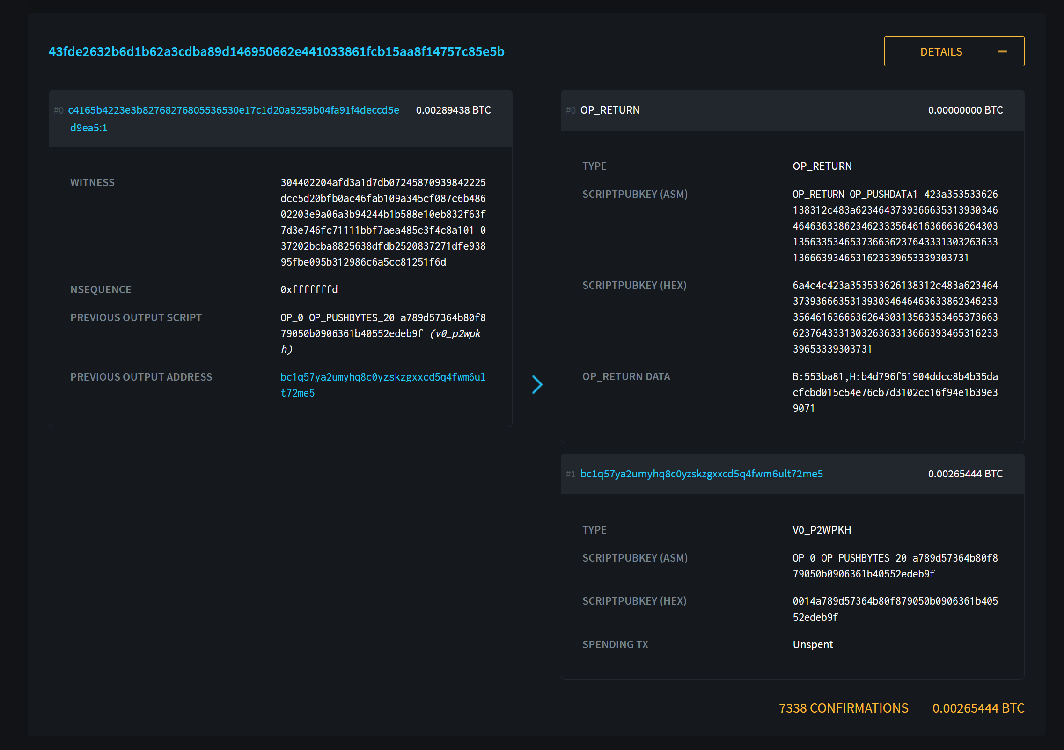

Slide 28
Transaction Protocols – Interesting Cases – Replacing Transactions on the Ethereum Blockchain
!!!! My Transaction Is Stuck !!!!
Low Gas Fees: Ethereum transactions rely on miners to process them. Miners prioritize transactions with higher gas fees, which act like a tip for their work. If you set a low gas fee, especially during busy times on the network, your transaction might get stuck waiting for a miner to pick it up.
Nonce Issues: Each transaction has a unique nonce number that helps prevent replay attacks. If you accidentally send a transaction with an incorrect nonce, like skipping a number in the sequence, the network might wait for all the previous transactions to be processed first, causing a delay.

Slide 29
Transaction Protocols – Interesting Cases – Replacing Transactions on the Ethereum Blockchain
Transactions Can't Be Replaced After Mining: Once a transaction is mined and included in a block on the blockchain, it's permanent and cannot be cancelled or replaced.
Replacing Pending Transactions (Possible): If your transaction is stuck as "pending" due to low gas fees or nonce issues, you might be able to replace it with a new transaction. This involves sending a new transaction with the same nonce but a higher gas fee.
Here are some things to keep in mind:
This process isn't guaranteed to work and requires careful execution.
It only works with wallet interfaces that allow customizing transaction nonce (e.g., MetaMask with advanced settings enabled).

Slide 30
Transaction Protocols – Interesting Cases – Replacing Transactions on the Ethereum Blockchain
Find the Transaction Nonce: Etherscan will usually display the nonce associated with your pending transaction. You'll need this for the new transaction.
Increase Gas Fee (Optional): Gas fees are dynamic. Consider using a higher gas fee for the replacement transaction to incentivize miners to pick it up sooner.
Use Wallet's Advanced Settings (if possible): Not all wallets allow this, but some like MetaMask have an "Advanced" section where you can override the default nonce.
Create New Transaction with Same Nonce: Initiate a new transaction within your wallet. Set the recipient address to your own wallet address. Enter an amount of 0 ETH (since this is essentially a cancellation).
Set Replacement Transaction's Nonce: In the advanced settings (if available), enter the nonce you obtained from the pending transaction.
Broadcast the Replacement Transaction: Once you've reviewed everything, submit the new transaction with the higher gas fee (if applicable) and the matching nonce.

Slide 31
Transaction Protocols – Interesting Cases – Replacing Transactions on the Ethereum Blockchain

Slide 32
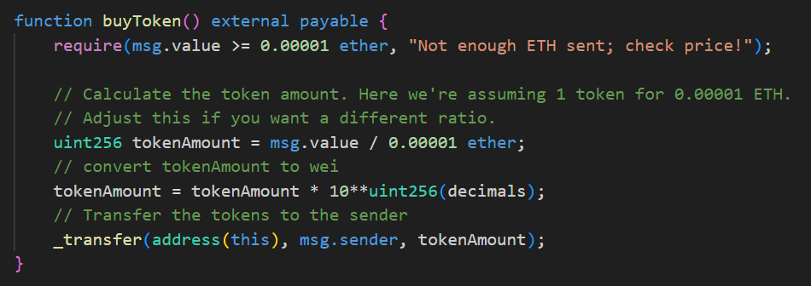
Tutorial 4 Primer
Payables
The ERC-20 ammeded with an operation that also receives SETH
Crucial to the purchase ticket feature

Slide 33
Quiz
The ERC-20 token standard defines a set of functions and events that all ERC-20 tokens must implement.
The "transfer" function in an ERC-20 token allows anyone to spend tokens from another user's account.
The Bitcoin consensus mechanism is Proof-of-Stake (PoS).
UTXOs (Unspent Transaction Outputs) are the foundation of how Bitcoin transactions work.
JSON RPC (JSON Remote Procedure Call) is a way for applications to interact with Ethereum nodes.
The "eth_call" method in Ethereum JSON RPC is used for sending transactions to the network.
The "data" field in an Ethereum JSON RPC request for an ERC-20 token balance check encodes the function call for "balanceOf".
There is a limit on the amount of data that can be stored using OP_RETURN on the Bitcoin blockchain due to transaction fees.
Replacing a pending Ethereum transaction with a higher gas fee is guaranteed to be successful.
Proof-of-Work (PoW) and Proof-of-Stake (PoS) are both consensus mechanisms used to secure blockchains.
Gas in Ethereum transactions refers to the computational effort required to execute a transaction.
The total value of input UTXOs in a Bitcoin transaction must be less than the sum of the outgoing payment.
Your Bitcoin wallet balance is stored in one central location on the blockchain.
Smart contracts are not possible on the Bitcoin blockchain.
The function selector in an Ethereum JSON RPC request is the entire Keccak-256 hash of the function signature.

Slide 34
Quiz
The ERC-20 token standard defines a set of functions and events that all ERC-20 tokens must implement. (True) ✅
The "transfer" function in an ERC-20 token allows anyone to spend tokens from another user's account. (False) ❌
The Bitcoin consensus mechanism is Proof-of-Stake (PoS). (False) ❌ - Bitcoin uses Proof-of-Work (PoW).
UTXOs (Unspent Transaction Outputs) are the foundation of how Bitcoin transactions work. (True) ✅
JSON RPC (JSON Remote Procedure Call) is a way for applications to interact with Ethereum nodes. (True) ✅
The "eth_call" method in Ethereum JSON RPC is used for sending transactions to the network. (False) ❌ - "eth_call" is used for read operations (like checking balances).
The "data" field in an Ethereum JSON RPC request for an ERC-20 token balance check encodes the function call for "balanceOf". (True) ✅
There is a limit on the amount of data that can be stored using OP_RETURN on the Bitcoin blockchain due to transaction fees. (True) ✅
Replacing a pending Ethereum transaction with a higher gas fee is guaranteed to be successful. (False) ❌
Proof-of-Work (PoW) and Proof-of-Stake (PoS) are both consensus mechanisms used to secure blockchains. (True) ✅
Gas in Ethereum transactions refers to the computational effort required to execute a transaction. (True) ✅
The total value of input UTXOs in a Bitcoin transaction must be less than the sum of the outgoing payment. (False) ❌ - It must be equal to or greater than.
Your Bitcoin wallet balance is stored in one central location on the blockchain. (False) ❌ - It's the sum of all your UTXOs.
Smart contracts are not possible on the Bitcoin blockchain. (True) ✅ (with some limitations)
The function selector in an Ethereum JSON RPC request is the entire Keccak-256 hash of the function signature. (False) ❌ - It's only the first 4 bytes.

Slide 35
Questions? No Case Study Lecture Today Tutorial Tomorrow 11-1

