Slide 1
Blockchain Technologies and Applications
ISE Block 8 – Week 2
06.11.19

Slide 2
Agenda
Lecture and Tutorial 1 Recap
Questions from last week.
Lecture 2: Cryptography in Blockchain
Importance of Cryptography in Blockchain
Secure value in an account
Secure transfer of that value to other accounts
Exercise transfer SETH between your accounts
Merkle Tree / Hash Tree
Gas and transaction costs
Quiz
Tutorial 2 Introduction
What are Smart Contracts

Slide 3
Lecture and Tutorial 1 Recap
You learned:
What is blockchain
Why would you use it
How to create a keystore
How to unlock your keystore
How to top up your keystore
View your first transaction on the blockchain

Slide 4
What Happened in Tutorial 1 Code Samples - Create a Wallet
The Web3.js library is used in this HTML file to interact with the Ethereum blockchain. Specifically, it's used to create a new Ethereum wallet and generate a keystore file for it.
Here's how it works:
A new Web3 instance is created with var web3 = new Web3();. This instance provides access to the Ethereum-related functionality provided by Web3.js.
A new Ethereum wallet is created with var wallet = web3.eth.accounts.create();. This function generates a new private and public key pair, which is the basis for an Ethereum wallet. The wallet object returned by this function includes the wallet's address and private key.
The wallet's address and private key are then displayed in the HTML page with $("#walletAddress").val(wallet.address); and $("#privateKey").val(wallet.privateKey);.
The private key is encrypted with a user-provided password to create a keystore object. This is done with var keystore = web3.eth.accounts.encrypt(wallet.privateKey, password);. The keystore object is a JSON object that includes the encrypted private key and other information needed to decrypt it. This keystore object can be stored and used to access the wallet in the future.
The keystore object is then converted to a JSON string with JSON.stringify(keystore) and displayed in the HTML page.
This code provides a simple way to create a new Ethereum wallet and generate a keystore file for it using Web3.js. The user can then download this keystore file and use it to access their wallet in the future.

Slide 5
What Happened in Tutorial 1 Code Samples - Check Balance
uses the Web3.js library to interact with the Ethereum blockchain. It's designed to run in a web browser and is likely part of a larger web application. Here's a breakdown of what it does:
A new instance of Web3 is created and connected to the Sepolia test network at https://rpc2.sepolia.org.
const web3 = new Web3("https://rpc2.sepolia.org");
2. An event listener is set up for a button with the ID cryptoBalanceButton. When this button is clicked, the function defined inside the event listener is executed.
$("#cryptoBalanceButton").click(function() { // ... });
Inside the event listener function, the value of an input field with the ID walletAddress is retrieved. This value is expected to be an Ethereum address.
const walletAddress = $("#walletAddress").val();
The retrieved Ethereum address is validated using web3.utils.isAddress. If the address is valid, the balance of the address is retrieved using web3.eth.getBalance. If the address is not valid, an error message is displayed.
if (web3.utils.isAddress(walletAddress)) { // ... } else {
$("#errorMessage").text("Invalid wallet address");
$("#errorModal").css("display", "block");
}

Slide 6
What Happened in Tutorial 1 Code Samples - Check Balance
If the address is valid, web3.eth.getBalance is used to retrieve the balance of the address in wei. This function returns a Promise, so .then is used to specify a function that will be executed when the Promise resolves.
web3.eth.getBalance(walletAddress).then(function(balance) {
// ...
});
6. Inside the .then function, the balance is converted from wei* to Ether using web3.utils.fromWei, and then displayed on the page in an element with the ID cryptoBalance.
const balanceInEther = web3.utils.fromWei(balance, "ether");
$("#cryptoBalance").html("<strong>Crypto Balance: " + balanceInEther + " ETH</strong>");
This code allows users to enter an Ethereum address and check the balance of the address in Ether.
* What is Wei?
Similar to pennies to pounds, or cents to Euros
Subdivisions of whole ETH
1 Wei is 1*10¹⁸ ETH
1000000000000000000 Wei == 1 ETH

Slide 7
What DID NOT Happened in Tutorial 1 Code Samples
You did not interact with any smart contracts yet.
Coming in tutorial 2
Creating a wallet is completely a local operation
Checking balance interacts with the blockchain but not a smart contract
You did not create a server side
The purist philosophy of Dapps is that the blockchain is both your server side web app and data store.
You had local client side code only

Slide 8
Questions from last week
Actors
Ticket Purchaser
Buys a ticket
Checks his balance in his wallet
Transfers his ticket to the venue on entry
Doorman
Checks the balance of a ticket purchaser at the door to verify a presented wallet possesses a ticket
Checks after the transfer back the the venue that the wallet no longer possesses a ticket
Venue
Can check total supply of the tickets to monitor sales
NOTES:
These are use cases for the project.
Your single smart contract should fulfil these use cases.
Your contract will be an ERC-20 (covered in tutorial 3)
The only actor actually executing a transaction here is the Ticket Purchaser. “payable” transaction which will be covered in tutorial 4

Slide 9
Questions from last week
Your contract will be an ERC-20 contract (tutorial 3) that will be created with an initial supply for the specific event. No minting, just distribution
Your application is for a single event.
But what is a Smart Contract? We will introduce this in today’s lecture.

Slide 10
Importance of Cryptography on the Blockchain
Blockchains are distributed ledgers
Every node has a copy of the chain.
Information is stored in blocks
Multiple transactions
Each block contains data and a hash
Blocks are chained together chronologically

Slide 11
Importance of Cryptography on the Blockchain
Hashing: transforming data into a unique fingerprint
Inputs of any size result in a fixed-size output
Changing the input even slightly yields a completely different hash
Nearly impossible to reverse engineer the original data from the hash

Slide 12
Importance of Cryptography on the Blockchain
Hashing: Transforming data of any size into a fixed-size, unique value called a hash code or digest.
One-way function: Easy to compute the hash from the data, but very difficult (practically impossible) to recreate the original data from the hash.
Unique fingerprint: Even minor changes to the original data will result in a completely different hash.
Collision resistance: Highly unlikely for two different pieces of data to produce the same hash.
Security applications: Hashing is used in various security measures like verifying data integrity, password storage, and digital signatures (like those used in blockchain).

Slide 13
Importance of Cryptography on the Blockchain
How Hashing is used in Blockchain:
Securing Block Data:
Hash of entire block's data is created.
Hash acts as a unique fingerprint for the block's content.
Any modification to the data changes the hash, making tampering detectable.
Chaining the Blocks:
Each block stores the hash of the previous block.
Tampering with a past block alters its hash and all following blocks referencing it.
Modifying the blockchain history requires changing numerous blocks and their hashes.

Slide 14
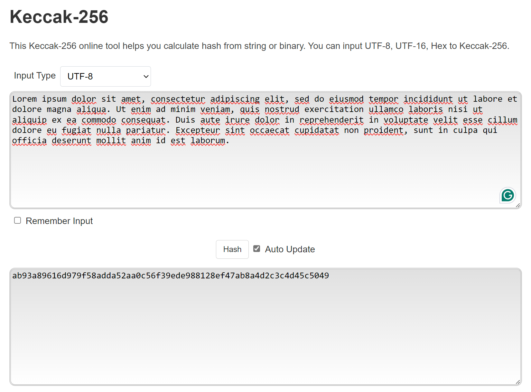
Importance of Cryptography on the Blockchain
Keccac-256 is the hashing algorithm primarily used in the Ethereum Blockchain
Keccak-256 - Online Tools (emn178.github.io)

Slide 15
Importance of Cryptography on the Blockchain
Merkle Trees – Hashing Data Structure of Blockchain
Block with Many Transactions: A single block in a blockchain can hold a large number of transactions.
Hashing Transactions: Instead of hashing all these transactions together in one go, Merkle Trees offer an optimized approach.
Merkle Tree Creation:
Each transaction is individually hashed.
Pairs of these transaction hashes are then hashed together.
This process of pairing and hashing continues until a single hash remains – the Merkle Root.
Merkle Root in the Block: The Merkle Root, representing all the transactions, is stored within the block header along with the block's hash.
Verifying Transactions: To verify if a specific transaction is included in a block, you don't need the entire block data. You only need the Merkle Proof – a path of hashes from the transaction's individual hash up to the Merkle Root.
Proof Verification: By following the Merkle Proof and comparing intermediate hashes, anyone can confirm if the transaction truly belongs to the block referenced by the Merkle Root.
Efficiency Benefit: Merkle Trees significantly reduce the data required to verify a transaction's inclusion in a block, making the process more efficient, especially for large blocks with many transactions.

Slide 16
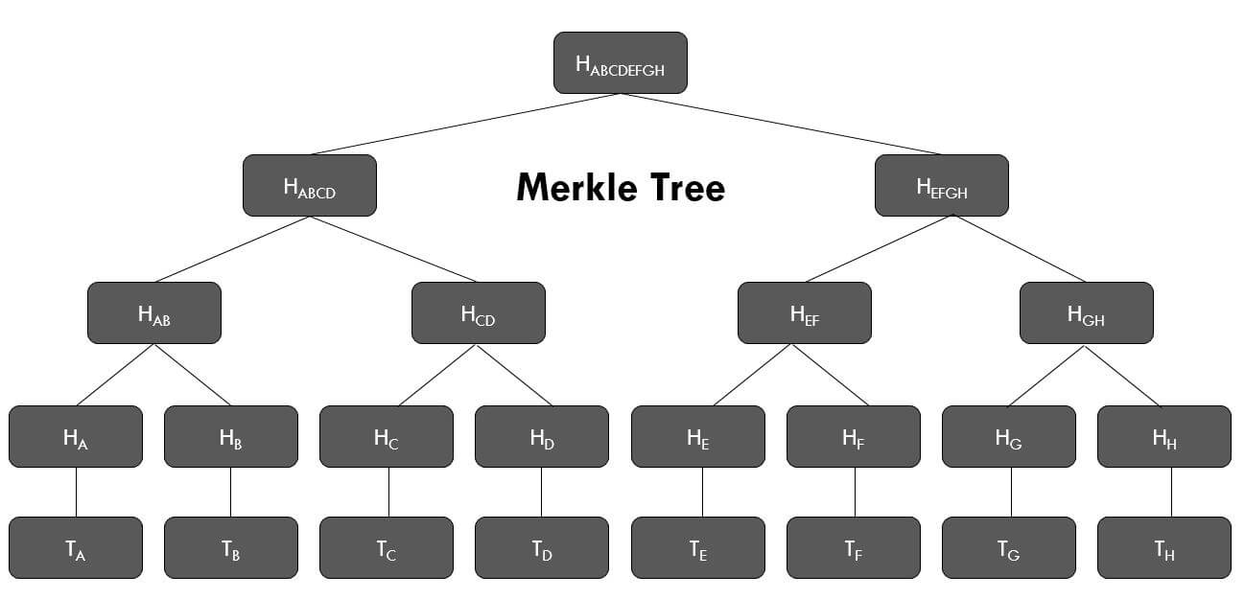
Importance of Cryptography on the Blockchain

Slide 17
Importance of Cryptography on the Blockchain
Digital signatures: like handwritten signatures, but for the digital world
Uses asymmetric cryptography with public and private keys
Sender uses private key to sign the transaction
Anyone can verify the signature using the sender's public key

Slide 18
Importance of Cryptography on the Blockchain
Sending a Transaction
Transaction Signing:
Sender initiates a transaction to transfer value on the blockchain.
The transaction includes details like recipient address, amount, and potentially additional data.
Private Key Involvement:
The sender uses their private key, a secret cryptographic key known only to them.
Digital Signature Creation:
The sender's private key mathematically signs the transaction data.
This signature acts as a digital proof that the transaction originated from the owner of the private key.
Broadcasting the Transaction:
The signed transaction is broadcasted to the blockchain network.
Signature Verification: Nodes on the network use the sender's public key (a mathematically related key derived from the private key but publicly known) to verify the digital signature.
Validating the Transaction: If the signature verification using the public key is successful, it confirms the transaction originated from the intended sender and the data hasn't been tampered with.
Authorization and Non-Repudiation:
This process ensures only the authorized owner (with the private key) can initiate the transaction, preventing unauthorized transfers.
Additionally, a successful signature verification provides non-repudiation, meaning the sender cannot deny they initiated the transaction.

Slide 19
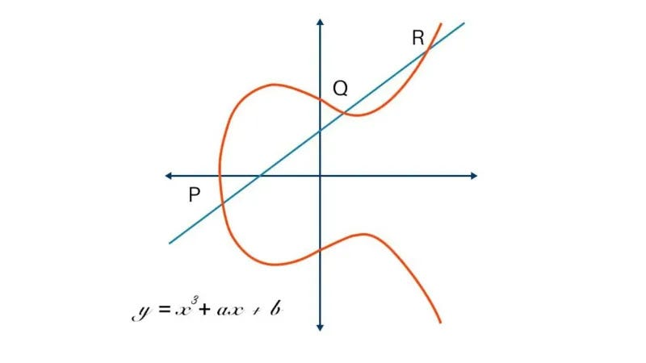
Importance of Cryptography on the Blockchain
Elliptic Curve Cryptography (ECC):
A cryptographic technique based on the mathematical properties of elliptic curves.
Offers smaller key sizes compared to traditional methods for similar security levels.
This translates to faster processing and reduced storage requirements.
ECC in Blockchain:
Digital Signatures (ECDSA):
Blockchain transactions often use Elliptic Curve Digital Signature Algorithm (ECDSA).
ECDSA leverages ECC to create digital signatures for transactions.
The sender uses their private key (an ECC keypair element) to sign the transaction data.
The signature mathematically proves the transaction originated from the private key owner.

Slide 20
Importance of Cryptography on the Blockchain
In Elliptic Curve Digital Signature Algorithm (ECDSA), commonly used for signing transactions in blockchain, r and s are components of the digital signature itself, while v plays a role in signature verification. Here's a breakdown:
r and s: These are integer values that together form the ECDSA signature.
They are mathematically derived from the message being signed, a hashing function, and the signer's private key.
The specific calculations involve complex elliptic curve operations.
Both r and s are crucial for a valid signature – a change in either value would render the signature invalid.
v: This is a value indicating which half of the elliptic curve was used during the signing process.
In elliptic curve cryptography, there are often two valid points for a given mathematical operation.
v helps identify which point was used to create the signature (often denoted as v = 0 or v = 1).
Verification Process: During signature verification, the recipient uses the signer's public key, the message, and the provided r, s, and v values.
Through mathematical operations on the elliptic curve, the verification process attempts to recover the same point used to generate the signature.
If successful (meaning recovered point matches the message and public key), the signature is considered valid.
v plays a role in this process by indicating which curve point to consider during verification.

Slide 21
Importance of Cryptography on the Blockchain
{
"jsonrpc": "2.0",
"id": 1,
"result": {
"blockHash": "0x74b68739d1302a7b4985097709d7cfbee2dd1a5e69a3ae10eccbcf784daf82fb",
"blockNumber": "0x12b6399",
"from": "0x95222290dd7278aa3ddd389cc1e1d165cc4bafe5",
"gas": "0xabe0",
"gasPrice": "0x4c9ea9efa",
"maxPriorityFeePerGas": "0x0",
"maxFeePerGas": "0x4c9ea9efa",
"hash": "0xeac2f81ee7dcd23bf23f052000a7fe0d2750f8b049993d53215db29905bf70ae",
"input": "0x",
"nonce": "0xd24e7",
"to": "0xcc20850f1907be2aab7474b9819112e37e630d7b",
"transactionIndex": "0x7f",
"value": "0x43b8116b275bc13",
"type": "0x2",
"accessList": [],
"chainId": "0x1",
"v": "0x0",
"r": "0x5d27f9c5a32d7678b68ddd627f6446cc64b1fdcb21396bd44a86892a4a54083e",
"s": "0x52bc8f612516fa6ebdb9d57aa400fdcbae7f22efd800efa442ec752f0f6a4da9"
}
}

Slide 22
Importance of Cryptography on the Blockchain
blockHash: The hash of the block where this transaction is included ("0x74b68739d1302a7b4985097709d7cfbee2dd1a5e69a3ae10eccbcf784daf82fb").
blockNumber: The block number where the transaction resides (represented as a hexadecimal string, "0x12b6399").
from: The sender's address on the Ethereum network ("0x95222290dd7278aa3ddd389cc1e1d165cc4bafe5").
gas: The total amount of gas provided for the transaction ("0xabe0", equivalent to 4,416 in decimal). Gas is the unit used to measure the computational effort required to execute a transaction on the Ethereum network.
gasPrice: The price the sender is willing to pay per unit of gas ("0x4c9ea9efa", a specific gas price value).
maxPriorityFeePerGas: This field is present for transactions adhering to EIP-1559 (fee market upgrade for Ethereum). Here, it's set to "0x0", indicating no maximum priority fee was specified.
maxFeePerGas: Similar to gasPrice, this represents the maximum fee per gas the sender is willing to pay (same value as gasPrice in this case).
hash: The unique identifier of the transaction itself ("0xeac2f81ee7dcd23bf23f052000a7fe0d2750f8b049993d53215db29905bf70ae").
input: This field contains data specific to the transaction (empty here, denoted by "0x"). It could include function calls for interacting with smart contracts.

Slide 23
Importance of Cryptography on the Blockchain
nonce: A value used to prevent replay attacks (repeated sending of the same transaction). It increases with each transaction sent by an address ("0xd24e7").
to: The recipient's address on the Ethereum network (potentially a smart contract address, "0xcc20850f1907be2aab7474b9819112e37e630d7b").
transactionIndex: The index of the transaction within the block it's included in ("0x7f").
value: The amount of Ether (ETH) being transferred in the transaction ("0x43b8116b275bc13", equivalent to 0.1 ETH).
type: The transaction type (here, "0x2" which signifies a simple transfer of ETH between accounts).
accessList (empty here): This field is used for EIP-2930 (transactions with private data) and is not relevant in this case.
chainId: The identifier of the Ethereum network this transaction belongs to ("0x1", signifying the Ethereum mainnet).
v, r, s: These represent components of the digital signature used to validate the transaction (explained in detail below).
v: Indicates which half of the elliptic curve was used during signing ("0x0" in this case).
r, s: Integer values forming the ECDSA signature itself.

Slide 24
Exercise – Send a Transaction
Using a wallet you created
Imported into Metamask
Transfer a tiny amount of SETH from your wallet to the person next to you.
Transfer it back
Look up the transaction on the Sepolia blockchain explorer
How much did your transaction cost?
What was the gas price?
How much gas did it use?

Slide 25
What is Gas?
Gas: On the Ethereum network, gas is a unit used to measure the computational effort required to execute a transaction. Different transactions have varying complexities, and thus require different amounts of gas to be processed.
Gas Price: This represents the price a user is willing to pay per unit of gas for their transaction. The gas price is set by the user and is denominated in Gwei (a very small unit of Ether, ETH).
Transaction Fee: The total transaction fee is calculated by multiplying the gas used by the gas price (gas used * gas price). This fee is paid in ETH to miners or validators on the network who process the transaction.
Why it's Important:
Incentivizes Miners/Validators: The transaction fees act as an incentive for miners or validators on the Ethereum network to process transactions. They are rewarded in ETH for including transactions in blocks.
Prevents Spam: By requiring users to pay a gas fee, the network discourages spam transactions that would clog the network. Users need to weigh the cost of the transaction fee against the benefit of having their transaction processed quickly.
Controls Transaction Speed: Higher gas prices typically lead to faster transaction processing as miners prioritize transactions with higher fees. Users can adjust their gas price based on how urgently they need their transaction confirmed.
Network Security: Gas fees contribute to the overall security of the Ethereum network. By making it more expensive to spam or launch denial-of-service attacks, the network discourages malicious activity.

Slide 26
Pop Quiz
SHA-256 is the primary hashing algorithm used in the Bitcoin blockchain. (True/False)
A collision in hashing occurs when two different inputs produce the same hash output. (True/False)
Merkle Trees improve scalability in blockchains by reducing the size of the data stored in each block. (True/False)
Public key cryptography is used for both encryption and decryption in blockchain transactions. (True/False)
Elliptic Curve Cryptography (ECC) is more vulnerable to brute-force attacks compared to RSA encryption. (True/False)
In ECDSA, the private key is used to sign a transaction, and the public key is used for verification. (True/False)
The "v" value in an ECDSA signature indicates the elliptic curve used for signing (v = 0 or v = 1). (True/False)
Gas price on the Ethereum network is a fixed value set by the protocol. (True/False)
Miners on the Ethereum network are rewarded with transaction fees for processing transactions. (True/False)

Slide 27
Tutorial 2 Primer – Introducing Smart Contracts
Self-executing programs on a blockchain
Contracts contain state, and operations over that state
Executing an operation is a transaction and results in updated state stored on the blockchain
Can be used to implement agreements or records of ownership on the blockchain without the need for an intermediary
E.g. Ownership of securities, purchases of collectibles, land registries.

Slide 28
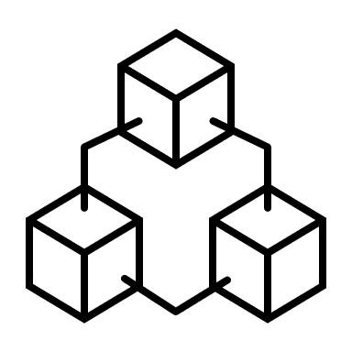
Tutorial 2 Primer – Introducing Smart Contracts
pragma solidity ^0.8.0;
contract Counter {
string public contractName;
uint public counter;
constructor(string memory name) {
contractName = name;
counter = 0;
}
function incrementCounter() public {
counter++;
}
function decrementCounter() public {
counter--;
}
}
Solidity: The language used to write smart contracts
Remix: An online compiler and deployment tool for smart contracts
Sepolia: A blockchain environment to deploy our smart contract to
Web3.js: A client library to interact with a deployed smart contract
incrementCounter()
counter
Client Page
Web3.js
Blockchain
constructor
Remix

Slide 29
Tutorial 2 – Thursday 2-4pm

